Slide 1
Investigate, Interact, Engage: Assessing Intercultural Competence in Practice
Presenters: Dr. Amanda Lanier | Michigan State University
Mike Nunley | Decatur High School
SCOLT 2024 | March 8 | 4:20-5:20 pm

Slide 2
Investigate, Interact, Engage: Assessing Intercultural Competence in Practice
Dr. Amanda Lanier
Michigan State University
https://lanierlingvista.org
Mike Nunley
Decatur High School
https://mikenunley.commons.msu.edu
Language learners can expect to encounter cultural differences while traveling abroad, but travel is not a guaranteed path to intercultural competence (ICC). To cultivate intercultural skills like observing products, interpreting practices, and shifting perspectives, we have to break culture out of its box on the textbook page and recognize ICC as it emerges. Drawing upon action research conducted during a class trip to in Spain, the presenters will demonstrate a practical framework for eliciting learner reflections and assessing ICC.
Notes:
The full proposal:
Language learners can expect to encounter cultural differences while traveling abroad, but travel is not a guaranteed path to intercultural competence (ICC). To cultivate intercultural skills like observing products, interpreting practices, and shifting perspectives, we have to break culture out of its box on the textbook page and recognize ICC as it emerges. Drawing upon action research conducted during a class trip to in Spain, the presenters will demonstrate a practical framework for eliciting learner reflections and assessing ICC.
The primary goals of this session are to help teachers differentiate between teaching culture as knowledge versus intercultural skills and to provide an adaptable rubric for analyzing learner reflections. Through analyzing authentic examples and applying the rubric, participants will improve their ability to guide and track ICC development in learners.
From the beginning, participants will encounter examples of activities and reflection prompts that are intended to elicit evidence of ICC. Using slides, a shared online template, a polling app (PollEverywhere), and handouts, teachers will analyze learner reflections, compose appropriate feedback, and begin adapting criteria for their own use.

Slide 3
Investigate, Interact, Engage: Assessing Intercultural Competence in Practice
Session Number: 5-0
Dr. Amanda Lanier & Mr. Michael Nunley

Slide 4
What do you teach when you teach culture?

Slide 5
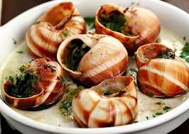
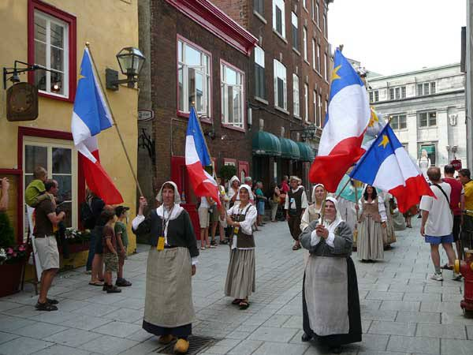
What do you teach when you teach culture?
FOOD
FLAGS
FESTIVALS

Slide 6
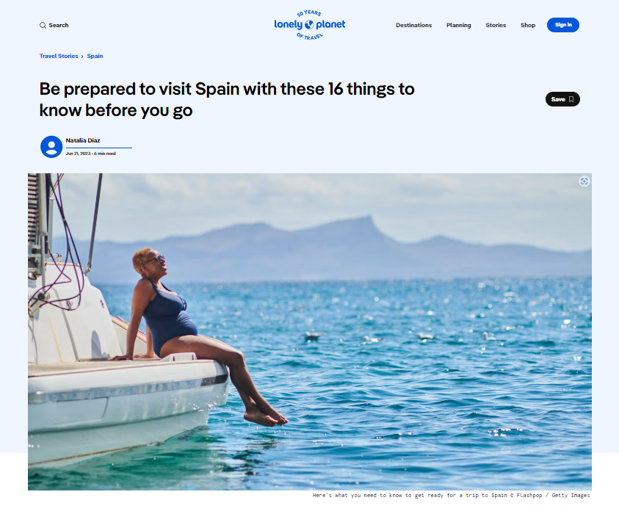
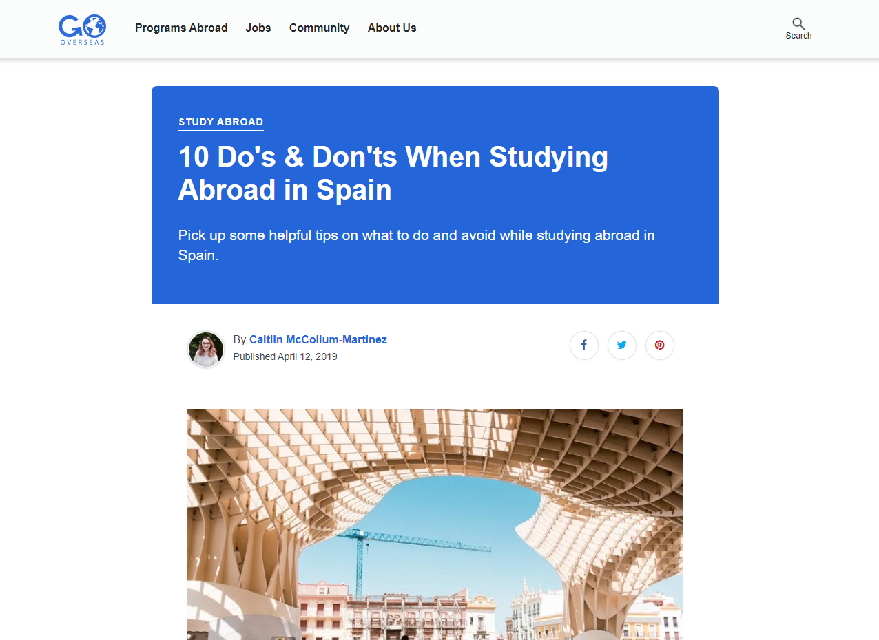
Notes:
https://www.lonelyplanet.com/articles/things-to-know-before-traveling-to-spain
https://www.gooverseas.com/blog/10-donts-when-studying-abroad-in-spain

Slide 7
What do you tell someone who is going to Spain for the first time?
“4. Do Embrace the Spanish Lifestyle”

Slide 8
[Add your answer]

Slide 9
Which advice is cultural? Which advice is intercultural?
“4. Do Embrace the Spanish Lifestyle”

Slide 10
Cultural Knowledge
Intercultural Attitudes or Skills

Slide 11
Travel Abroad with Spanish Learners

Slide 12
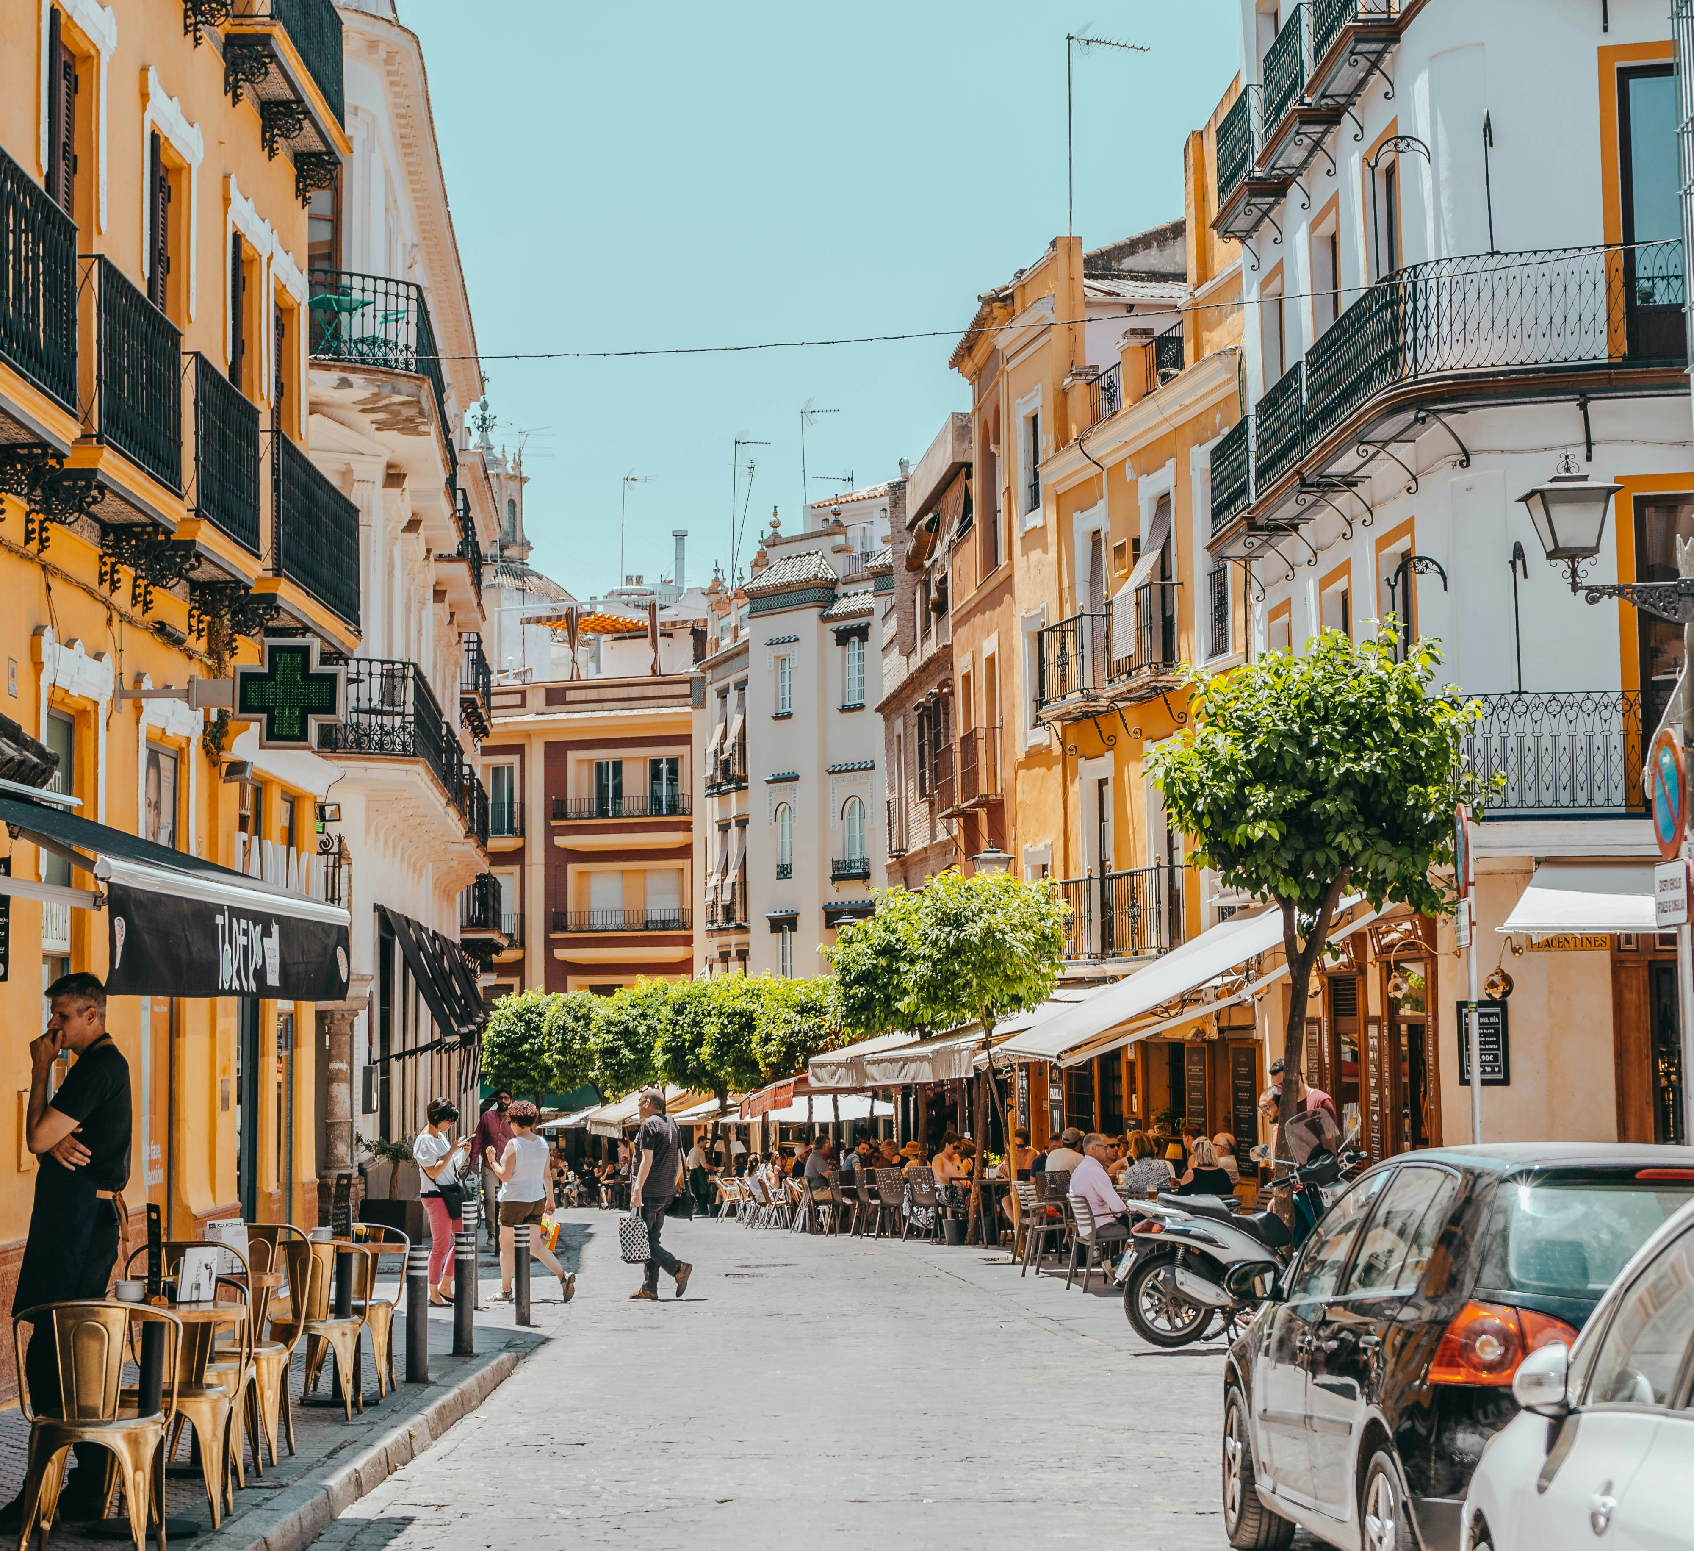
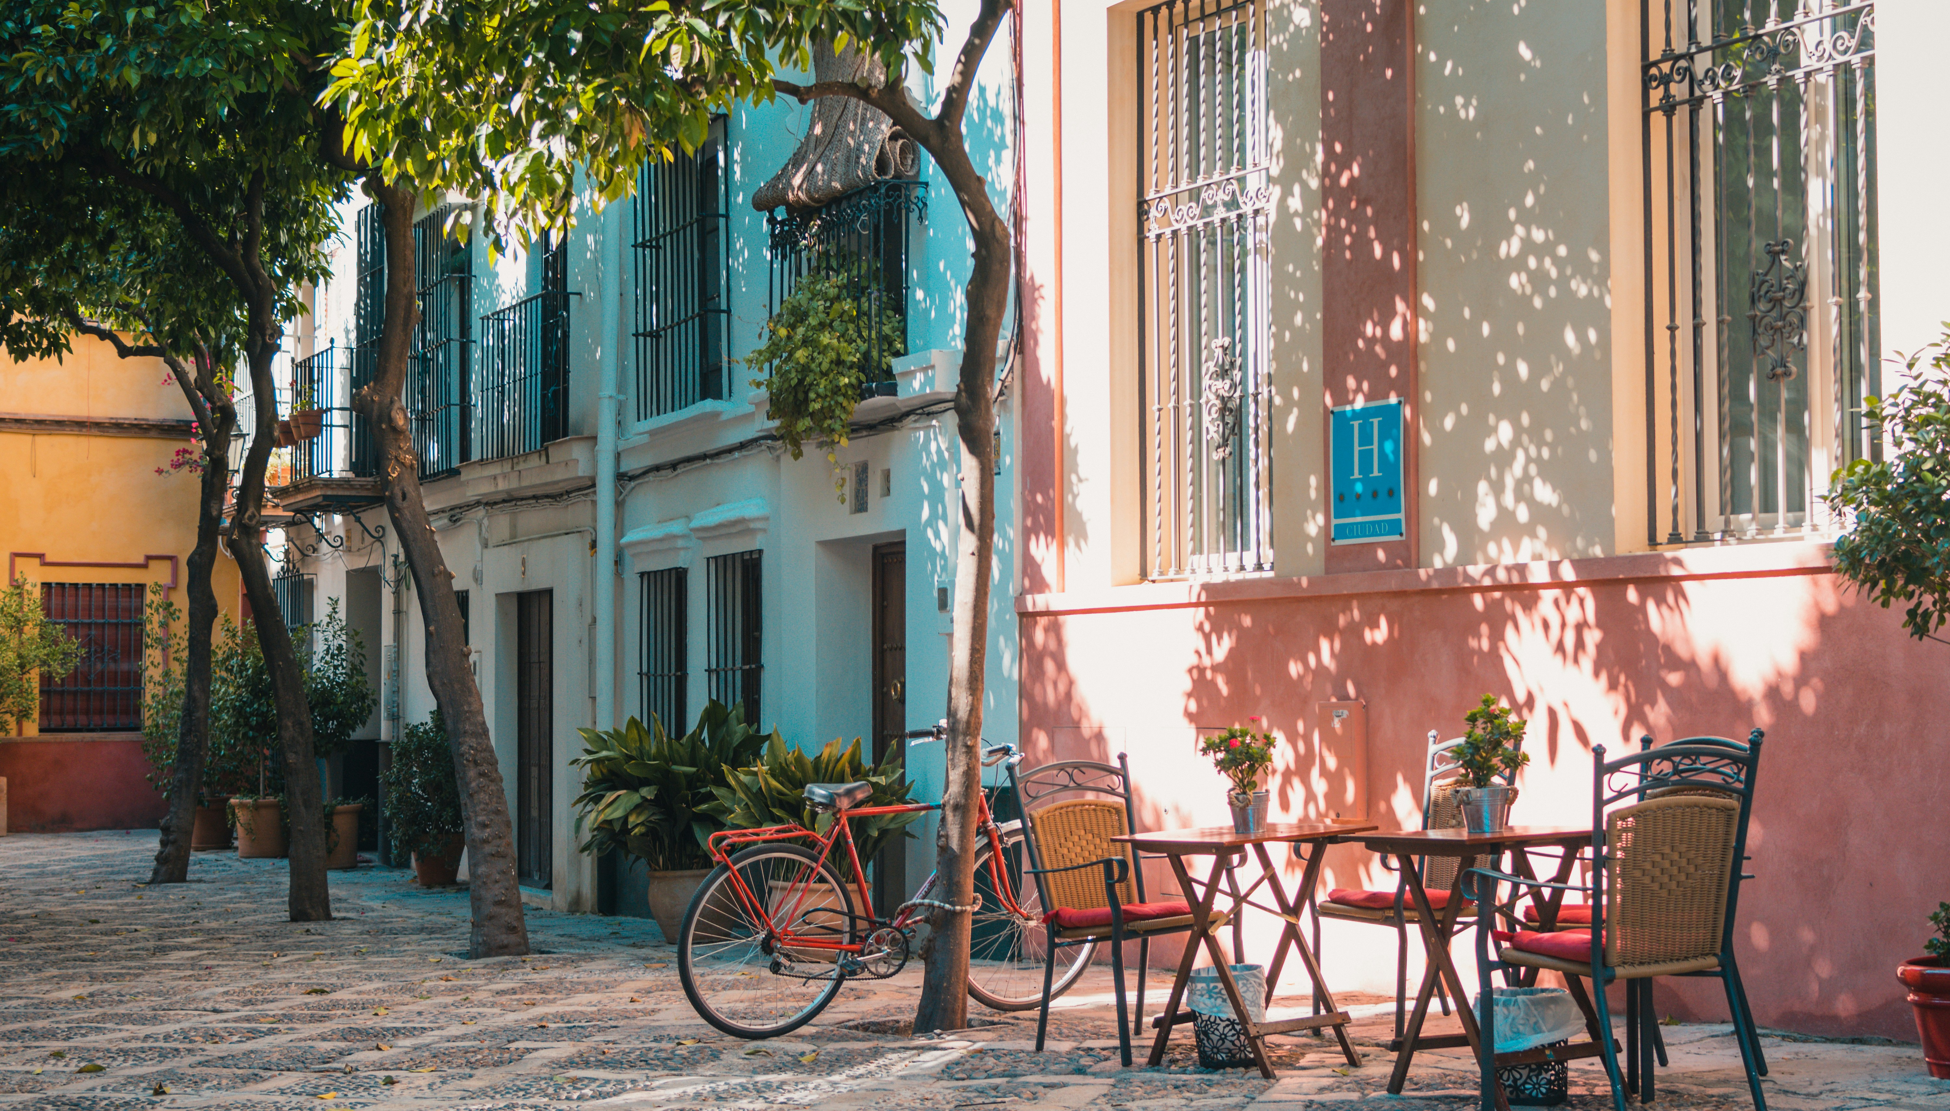
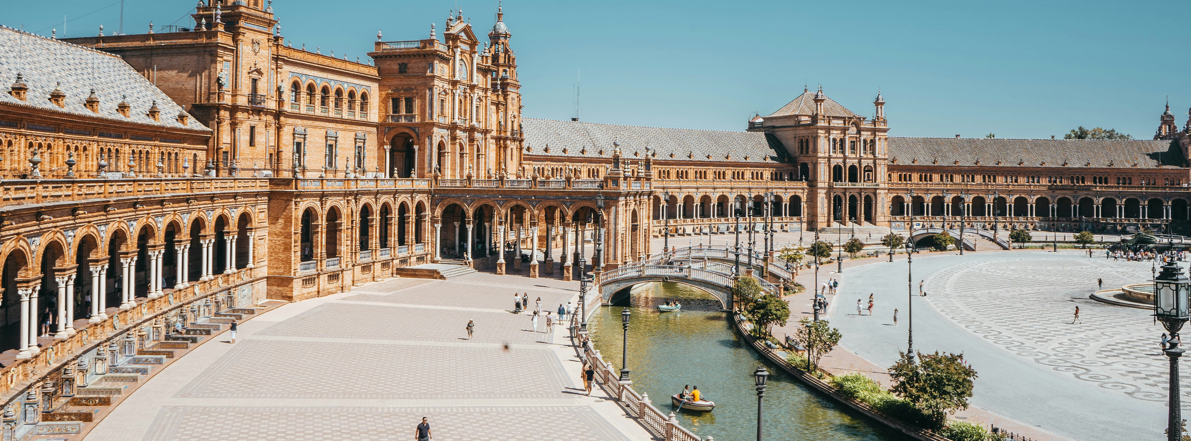

Slide 13
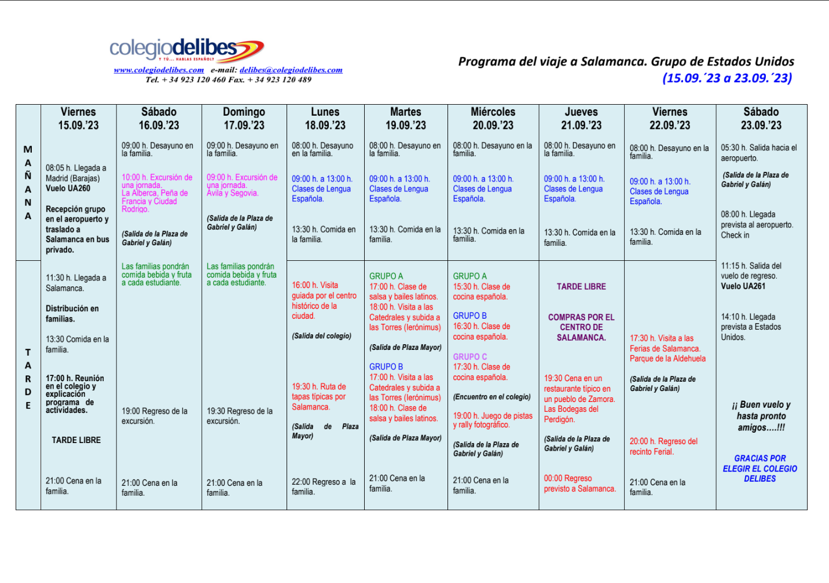
Notes:
Photo by Reiseuhu on Unsplash

Slide 14
Informational Meeting

Slide 15
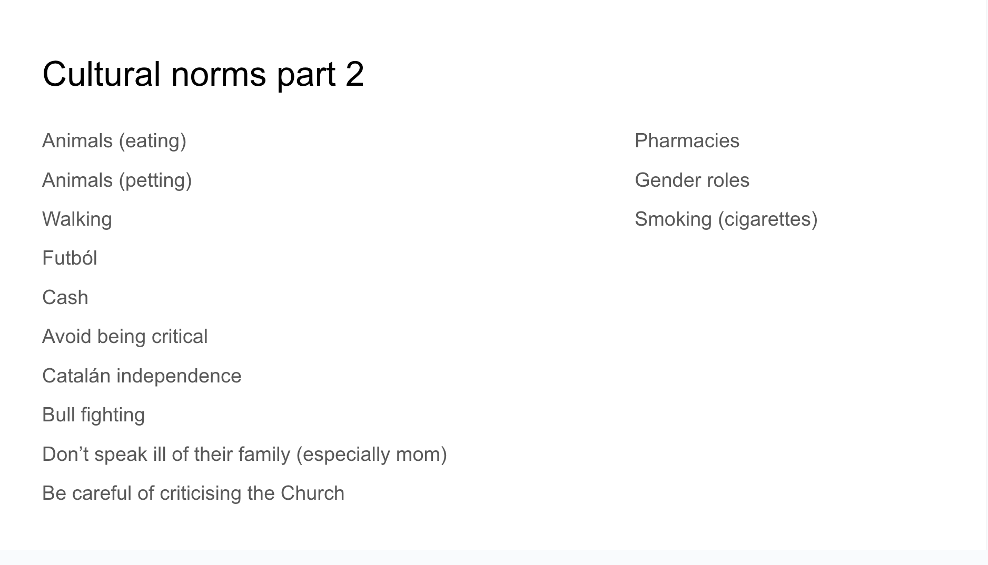
Informational Meeting

Slide 16
Linguistic and Sociolinguistic Competence

Slide 17
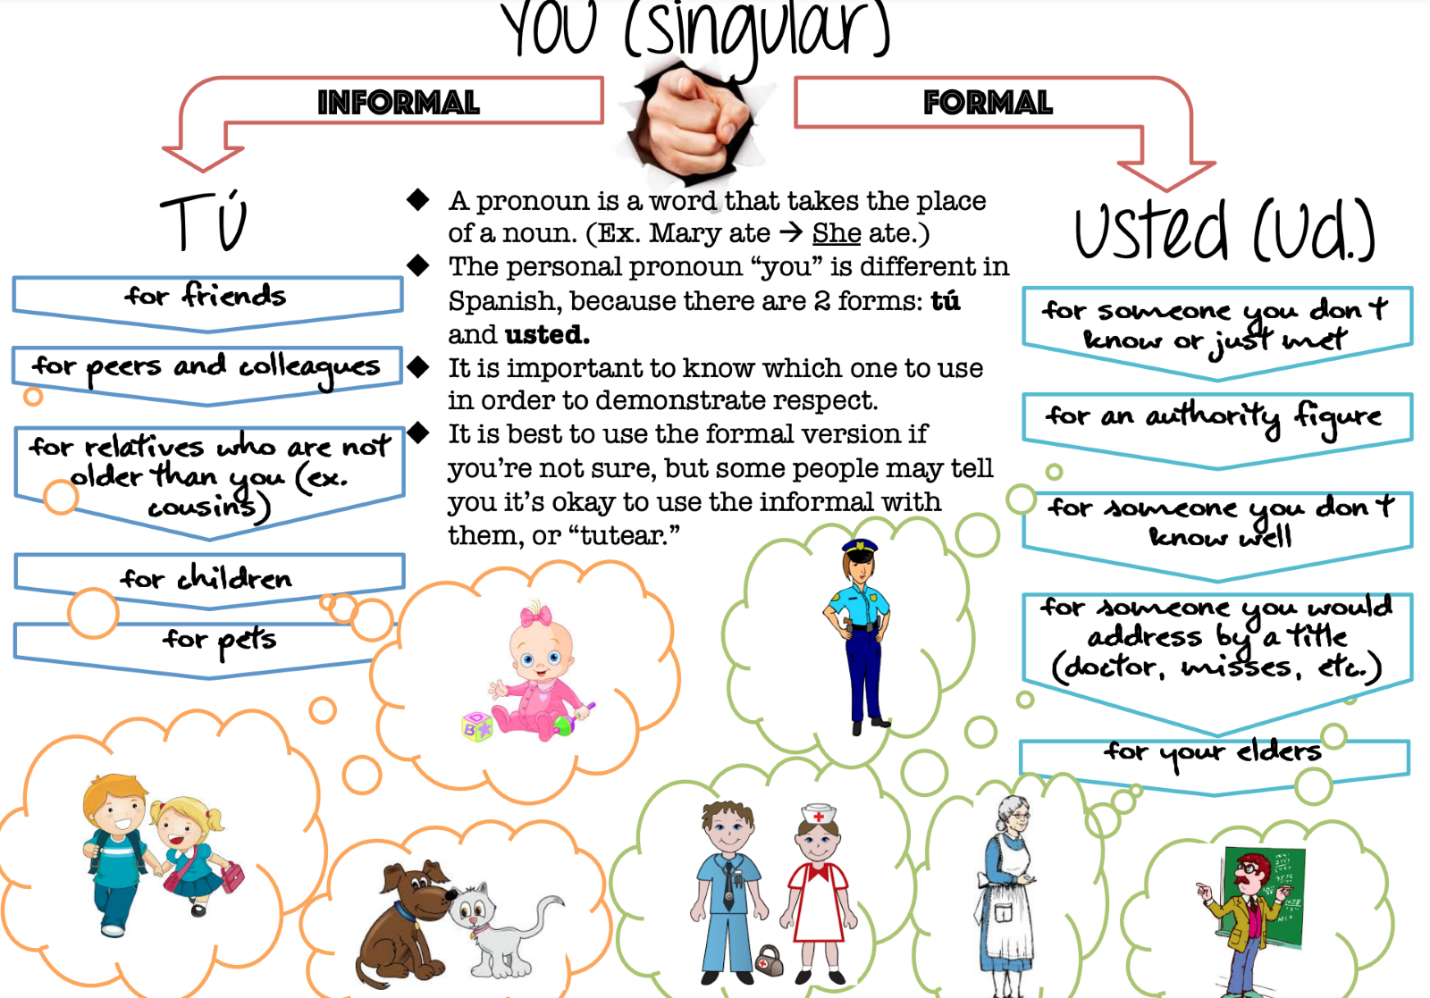

Slide 18
Persona 1: Madre Persona 2: Su hijo
¿Hola mijo, cómo estás?
Bien, ¿quieres almuerzo? Voy a cocinar sopa de pollo.
Sí mijo, gracias.
Hola mamá, bien, y usted?
Vale. ¿Tiene todas ingredientes?
Notes:
Person 1: mom, Person 2: her son:
1: Hello son, how are you?
2: Hi mom, good, and you?
1: Good, do you want lunch? I'm going to make chicken soup.
2: Okay, do you have all the ingredients?
1: Yes son, thank you.

Slide 19
Teacher Research: Intercultural Competence during study abroad

Slide 20
Experiential Module Project for MAFLT
Capstone project for MAFLT Program – bring together what you have learned and create something meaningful for you and other teachers.
Students enroll in 5 credits of FLT 885 to plan and complete the project.
Designed by the student, supervised by a dedicated faculty mentor whose skills and interests align with your project.
Many possible types – intended to draw from your experience and serve your professional goals.
Generates evidence of your work and skills to be shared in your portfolio.
https://maflt.cal.msu.edu/experiential-modules

Slide 21
Teacher Research - Participants
Spanish Learners
22 high school seniors who are 17 and 18 years old
Out of 50 total students who went on the trip
Taking Spanish for 7 years
Speaking ranges from intermediate mid to advanced low proficiency
15 of the participants were female and 7 were male.
21 were English dominant and 1 was bilingual.
15 identified as white, 3 identified as black, and the other 4 identified as some mix of white, black, and Latinx
Participation and retention
Of those 22, 12 responded to both pre and post survey.
Of those 12, 10 of them responded to all five survey prompts.

Slide 22
Teacher Research – Data Collection
Pre trip survey
Reflection Prompts
Post trip survey
Interviews
← Everyone (Ideally) →
Selected sub-set →
Notes:
Students completed the pre-survey before we left for Spain and the same survey once we returned from Spain. This survey could be done anytime on their own after one of the three informational meetings.
During the trip, 5 reflective prompts were given that students were supposed to respond to after the activity that we did together that day.
Of the 22 who participated in our study, 12 responded to both pre and post survey. Of those 12, 10 of them responded to all five survey prompts. As the trip went on, less and less people responded to prompts. Prompt 1 had 14 responses, prompt 2 had 13 responses, prompt 3 had 12 responses, prompt 4 had 10 responses and prompt 5 had 12 responses. The only reason that there was a spike back up at the end was because of a final push by me to make sure students were completing all 5 prompts.

Slide 23
Questionnaires – Pre-Trip / Post-Trip
Demographic Questions
Strongly Disagree | Disagree | Agree | Srongly Agree
2. I know the essential norms and taboos of Spanish-speaking cultures (e.g., greetings, dress, behaviors, etc.)
4. I have a clear sense of my cultural background and what it means for me.
12. When learning about teenagers from Spanish-speaking cultures, I notice a lot of similarities to me and my friends in the U.S.
17. I feel confident when interacting with people from different cultures.
20. I find it difficult to talk with people from different cultures, even if we speak the same language.
24. I can name important historical and socio-political factors that shape my own culture and the culture(s) of Spanish-speaking people(s).
25. I can identify how Spanish-speaking people might view me and why.
27. I can identify how my values, ethics, and culture are reflected in how I react to specific situations.
Age
Gender
Race/ethnicity
Length of Spanish study
Other languages studied
Languages at home
Travel experience

Slide 24
Reflection Prompt Topics
What do you notice?
Tell stories
Compare differences
At Home
On the Street
At Cultural Sites
People You Meet
In Shops and Restaurants
Think of your home in the US and the home you are staying in during this trip. What similarities and differences have you noticed between your two homes? Additionally, if you can think of any stories describing interactions with family members that stand out, please provide them.
What similarities and differences have you noticed about things like your commute, how people get around town, the behavior of people in common areas like public transportation and as you’re walking down the street, and how you navigate your way around Salamanca?
What topics, people, and events are being celebrated at these monuments and locations? Did you notice any similarities or differences between what Americans value in their historical sites and history vs what Spaniards value?
Think about all the people you’ve met. Shop owners, cashiers, attendants, your Spanish family, your teachers and more. What have your interactions been like with these people? Have you noticed things being similar or different to how they are in the US? Has anyone said or done anything that may have shocked you due to it being different from how people behave in the US?
In Spain we have been out and about to different shops, cafes and restaurants. During these times, what have you noticed about being in each of the 3 locations? Provide examples of differences and similarities between how business is conducted in each place.

Slide 25
Frameworks and Standards for Teaching Culture

Slide 26
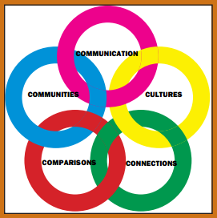
ACTFL Standards for FL Learning
ACTFL
Global Standards (5 C’s)
Proficiency Guidelines
Performance Descriptors
Can-Do Statements
www.actfl.org/publications/guidelines-and-manuals

Slide 27
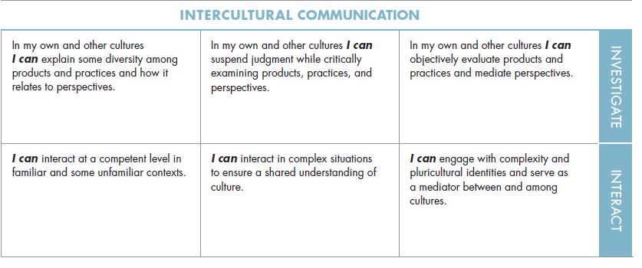
Intercultural Can-Do Statements
From the 2017 update to the NCSSFL-ACTFL Can-Do Statements:
https://www.actfl.org/publications/guidelines-and-manuals/ncssfl-actfl-can-do-statements
Products
Practices
Perspectives
The target?
“pluricultural” and “mediator”
Survival → Functional → Competent → Complex

Slide 28
Intercultural Standards & Curricula
ACTFL
American Council on the Teaching of FLs
ILR
Interagency Language Roundtable (mostly U.S. gov jobs)
CEFR
Common European Framework of Reference (Council of Europe)
School Systems
National level
State and local level

Slide 29
DEVELOPING ICC Cultural or Intercultural?
CULTURAL KNOWLEDGE
CROSS-CULTURAL EXPERIENCE
INTERCULTURAL SKILLS
Culture in language learning is not
an expendable fifth skill…
It is always in the background, right from day one, ready to unsettle the good language learners when they expect it least, making evident
the limitations of their hard-won
communicative competence,
challenging their ability
to make sense of the world
around them.
(Kramsch, 1993, p. 1)

Slide 30
DEVELOPING ICC Cultural or Intercultural?
CULTURAL KNOWLEDGE
CROSS-CULTURAL EXPERIENCE
INTERCULTURAL SKILLS
How will that experience lead to intercultural skills?
What stimuli will I provide so they can experience that content?
INTERCULTURAL ATTITUDES
What content will be the foundation?
Are they demonstrating intercultural attitudes?

Slide 31
How Intercultural Competence Develops

Slide 32
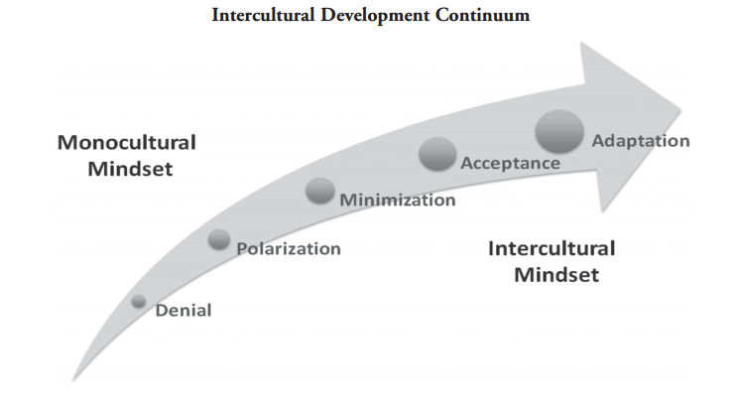
Intercultural Development Inventory
Intercultural Development Inventory – Milton Bennett
Hammer (2012, p. 119)

Slide 33
INTERCULTURAL COMPETENCE The Savoirs Framework - Council of Europe
Intercultural Competence for All (COE, 2012)
Cultural Knowledge (savoirs)
Intercultural attitudes (savoir être)
Skills of interpreting & relating (savoir comprendre)
Skills of discovery and interaction (savoir apprendre/faire)
Critical cultural awareness (savoir s’engager)
Byram, Gribkova, & Starkey (2002); Liddicoat & Scarino (2013)
Notes:
Keep

Slide 34
INTERCULTURAL COMPETENCE
Cyclical process of development over time:
“It is more important to study culture as a process in which learners engage rather than as a closed set of information that he/she will be required to recall.”
(Liddicoat & Scarino, 2013, p. 23)
Learning involves “a set of processes through which intercultural learners pass many times as they develop greater complexity of understanding.”
(Liddicoat & Scarino, 2013, p. 59)
Noticing
Interacting
Comparing
Reflecting

Slide 35
INTERCULTURAL COMPETENCE
Cyclical process of development over time:
Critical Cultural Awareness
Skills of
Interpreting and Relating
Skills of
Discovery and Interaction
Attitudes
Cultural Knowledge
Adapted from Byram & Zarate (1997); Byram, Gribkova, & Starkey (2002)
Notes:
Keep

Slide 36
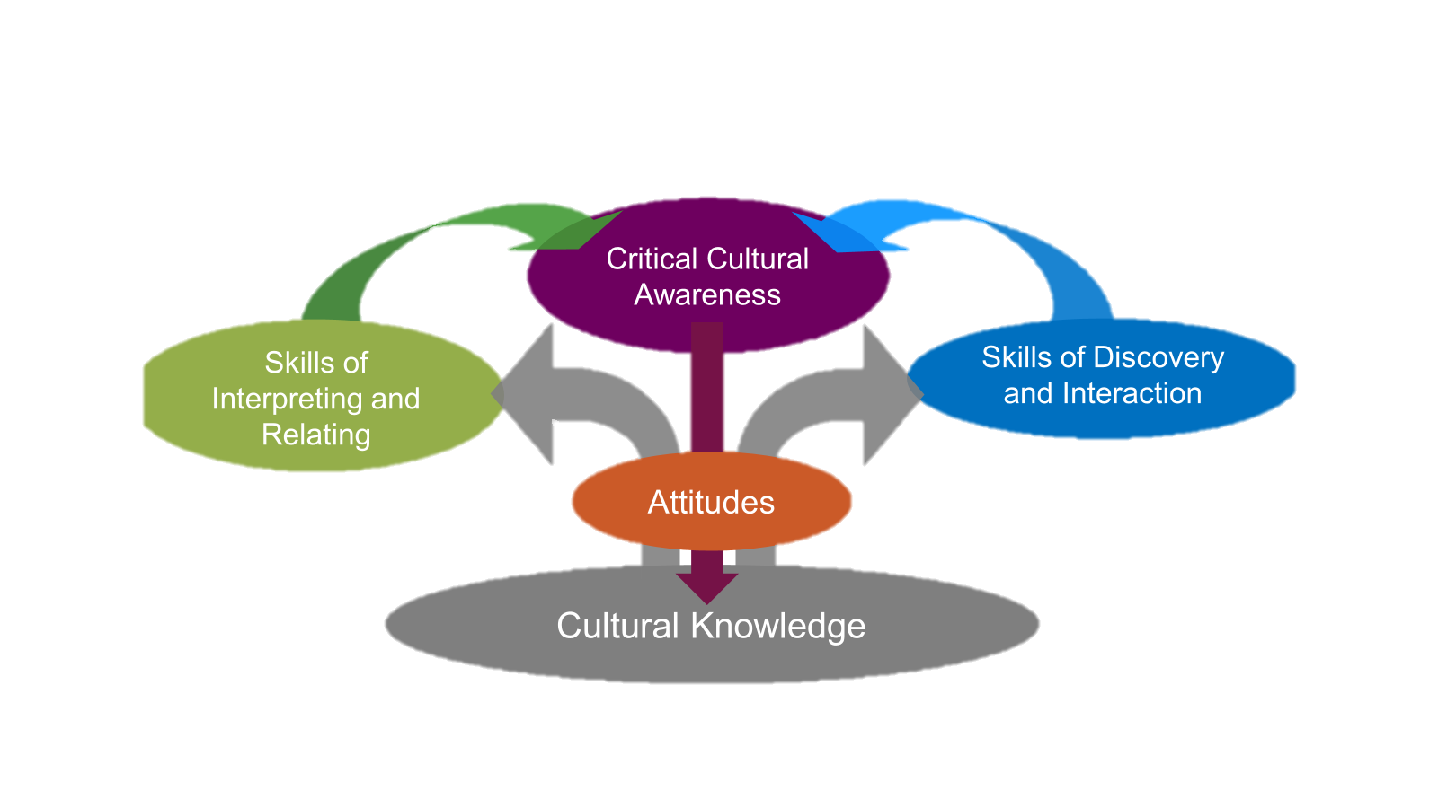
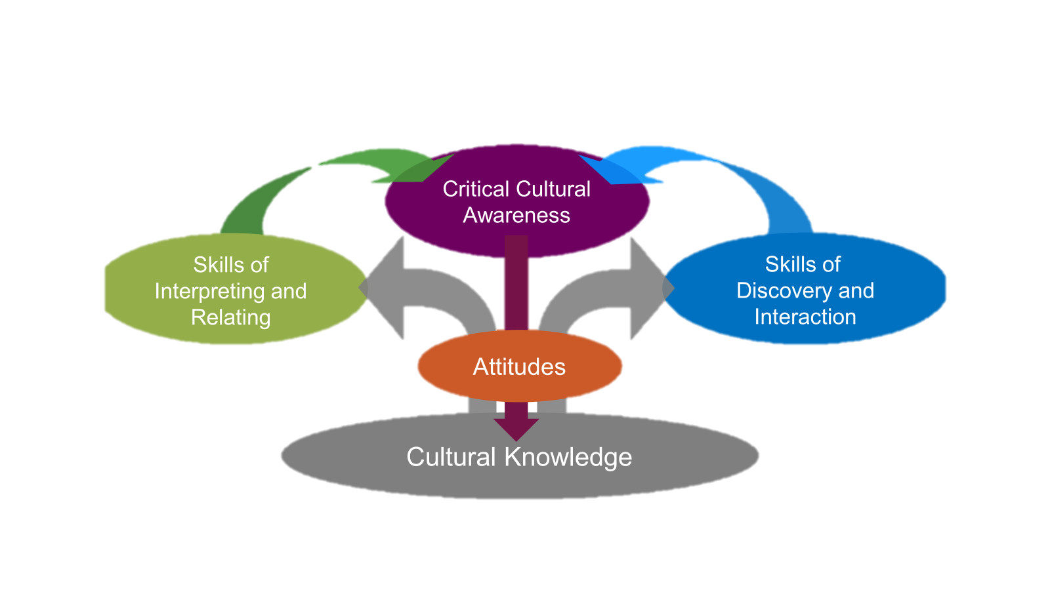
INTERCULTURAL COMPETENCE
Cyclical process of development over time:
Adapted from Byram & Zarate (1997); Byram, Gribkova, & Starkey (2002)
Notes:
Keep

Slide 37
FOUNDATIONS OF INTERCULTURAL FLT
Cultural knowledge is not intercultural competence.
It is a basis for developing ICC.
Intercultural teaching is completely compatible with communicative language teaching.
Proficiency and ICC can develop together, but
they may develop at different rates.
Cultural knowledge mainly applies to one cultural group and context. ICC can transfer to any language, group, or context.

Slide 38
Reflecting on ICC Development
The KASE Rubric

Slide 39
Do you see cultural knowledge? Do you see ICC attitudes and skills?
We found a table ourselves since there was no host, and a waiter brought us a menu and bread and asked for our drink orders. We both said water so they brought a 1.5 liter bottle of water.
We were asked a couple of times if we were ready to order because at first we needed more time. The person who asked us had to explain that we needed to order a first and second plate, and we couldn't only order one or the other.
He brought the first plate out and when it looked like we were finished someone came by to make sure we were ready for the second plate and then they brought that.
Otherwise no one checked on us like waiters do in the US, like "how's everything?" "can I get you anything else?
Prompt:
In Shops and Restaurants

Slide 40
INTERCULTURAL COMPETENCE
Cyclical process of development over time:
Engagement
Skills
Critical Cultural Awareness
Skills of
Interpreting and Relating
Skills of
Discovery and Interaction
Attitudes
Attitudes
Cultural Knowledge
Knowledge
K A S E
Notes:
Keep

Slide 41
KASE Rubric for ICC Growth
Knowledge Grows
Attitudes Adjust
Skills Improve
Engage Yourself
Now what are you looking for when you review these reflections?

Slide 42
KASE Intercultural Reflection Guide
Knowledge Grows
I know more about...
Attitudes Adjust
I want to explore more about...
Skills Improve
Engage Yourself
I adjusted my attitudes about...
I got better at... Next time I will…
Use KASE to guide creating the reflection prompts AND to assess them
Notes:
This activity is similar to the traditional KWL chart, but it is designed to put balanced emphasis on the components of ICC as opposed to the teaching of culture as content.

Slide 43
 | Criterion | ASK | Assessment Description (Desired Evidence – 4 points)
K | Knowledge | What did you learn about the cultural products, practices, or perspectives during this task? | You mentioned specific cultural products, practices, or perspectives and commented on what you learned about them during this task.
A | Attitudes | What did you think about those practices/products/perspectives? Did your opinions or perspectives about them change? How? | Your reflection demonstrates attitudes of openness and curiosity and comments on changes in your attitudes that resulted from this task. Your responses did NOT show evidence of over-generalization, bias, disgust, or assumption that your own cultural values and practices are superior.
S | Skills | How do you think you handled this cross-cultural experience? What skills did you use to interpret? To investigate? To interact? | Your reflection shows evidence of intercultural skills. Also, you commented on skills that you believe you used to complete this task. Skills include: comparing, relating, interpreting, using an informant, investigating further, adapting behavior based on context, adjusting your beliefs or practices, analyzing context, and more.
E | Engagement | What would you like to do better next time you encounter cultural products, practices, or perspectives like these? Do you think your intercultural competence improved as a result of this task? How? | You reflected on the development of your ICC, articulated ways that you could explore this cultural content further, and considered how you cross cultural boundaries more effectively in the future.
Notes:
Peer Interaction
Throughout this session, you interacted with your peers with respect, openness, and strategic competence. You contributed to the exchange of ideas (though you did not have to agree), avoided criticism or judgment of your peers as individuals, and helped move the conversation forward with questions and feedback. Your peers would be likely to feel comfortable with future opportunities to reflect with you. [Use if choosing Group response. Individual response assessments, delete this criterion or give points for task completion]

Slide 44
Why do we need to assess intercultural competence effectively?
CONVEYING
COMPETENCE
TO OTHERS
USING
COMPETENCE
WITH OTHERS
Serves as a credential in education and profession
Opens doors for educational or professional opportunities
Leads to opportunities for developing further competence
Improves social interactions
Leads to better intercultural experiences
Allows you to accomplish other goals that require crossing cultural boundaries effectively
Liddicoat & Scarino (2013)

Slide 45
Assessing icc Skills as they Develop

Slide 46
Do you see cultural knowledge? Do you see ICC attitudes and skills?
One large difference I noticed when walking around Salamanca was that nobody really jaywalked.
In the US, people jaywalk all the time when there are few cars on the road, but I never saw anybody jaywalk without a crosswalk, and even at crosswalks it was rare (definitely nobody over the age of 20).
Prompt:
On the Street

Slide 47
Do you see cultural knowledge? Do you see ICC attitudes and skills?
I've learned Spaniards are very proud of their cities’ rich histories. During my time in Spain, I have visited several cathedrals, schools, the castle of Queen Isabella and King Ferdinand, and other beautiful, historical places. We were lucky enough to get guided tours of all of these locations and learn about their past.
The stories our professors told us while we were touring these historic monuments were something out of a fairy tale. All history was deep rooted in legends and stories, weaving religion and local values throughout: love stories, riots, deals with the devil, etc.
It was nice to visit a place with such a rich, respected, history.
Prompt:
At Cultural Sites
Notes:
I find it difficult to celebrate American history. I've never really been taught how. In comparison to other countries, the U.S is fairly young, but its history is packed, mostly with unpleasant memories. I remember taking AP US History my Sophomore year. We covered all of American History, from the countries founding in 1492 up to the early 2000's. Thinking back on those 500 years of history, I remember wars, assassinations, social movements, and treaties. We as a country don't spend much time admiring the beauty in history or present day. It was nice to visit a place with such a rich, respected, history.

Slide 48
Do you see cultural knowledge? Do you see ICC attitudes and skills?
On my first night, I went to the plaza to watch a concert where I noticed another Black girl in front of me. I was surprised to see someone else who looked like me, and so were many of the concertgoers who kept looking at me and the other girl with shocked expressions on their face. I generally felt like I was constantly being watched and looked at by pedestrians.
On this same night, while I was at McDonald’s, a random lady started digging in my McDonald's bag for a "bathroom ticket" for her son. I stood there confused as the family eagerly asked me for a bathroom ticket because I did not know what that was. This invasion of my bag was shocking to my friends, who also had no clue what was happening.
Catcalling is an unfortunate but common occurrence for many women and girls in the United States. So far, I have only been catcalled one time since I have been in Spain, which is far less than expected due to its prevalence in the United States.
Prompt:
People You Meet

Slide 49
Do you see cultural knowledge? Do you see ICC attitudes and skills?
This was different because in the US even if you’re not helping to cook or clean you are expected to at least clear your plate and maybe help put some things away.
To me, it felt really disrespectful to leave everything out like that but it was normal there.
Prompt:
At Home

Slide 50
Do you see cultural knowledge? Do you see ICC attitudes and skills?
One thing my host mom did that stood out: I was sitting at the dinner table and she pulled my shirt away from my back to see what I was wearing under it (it was a racer-back bra so you could see it since the neckline was different from the shirt's neckline). She did it perfectly normally and complimented the bra.
This just stood out because it's not something an American adult hosting an exchange student would do, since we have different norms regarding personal space. I knew that at the time so I wasn't exactly uncomfortable with what she did, it was just unexpected.
Prompt:
People You Meet

Slide 51
Do you see cultural knowledge? Do you see ICC attitudes and skills?
I also saw that my host mom would often leave late to take care of her own mother. How close she was to her mother. That's just something I see within like, like black culture. Like close familial bonds and making sure you spend that alone time.
Those are similarities but like that’s - my culture is very - I think it revolves around finding communities and food but also maintain close relationships.
(Student 4, 2023)
Interview Data

Slide 52
Do you see cultural knowledge? Do you see ICC attitudes and skills?
I've learned Spaniards are very proud of their cities’ rich histories. During my time in Spain, I have visited several cathedrals, schools, the castle of Queen Isabella and King Ferdinand, and other beautiful, historical places. We were lucky enough to get guided tours of all of these locations and learn about their past.
The stories our professors told us while we were touring these historic monuments were something out of a fairy tale. All history was deep rooted in legends and stories, weaving religion and local values throughout: love stories, riots, deals with the devil, etc.
Interview Data
I find it difficult to celebrate American history. I've never really been taught how. In comparison to other countries, the U.S is fairly young, but its history is packed, mostly with unpleasant memories. I remember taking AP US History my Sophomore year. We covered all of American History, from the countries founding in 1492 up to the early 2000's. Thinking back on those 500 years of history, I remember wars, assassinations, social movements, and treaties. We as a country don't spend much time admiring the beauty in history or present day. It was nice to visit a place with such a rich, respected, history.

Slide 53
Developing ICC before travel
ICC Activities and Reflections

Slide 54
Choose your:
Products
Practices
Perspectives
Notes:
Students create a dialogue between two speakers (they’ll be assigned what speakers they’ll be playing the role of [student/teacher, parent/child, 2 best friends, etc].)
Their dialogue must include greetings, asking how the other is doing, something each person likes to do, and an appropriate way of saying goodbye.
Students will finish by recording their conversation to Flipgrid.

Slide 55
INTERCULTURAL TASKS Planning Process
Choose your:
Products
Practices
Perspectives
Content
Stimuli
Observation
Application
Debriefing
Reflection
Various entry points
Notes:
From Designing Intercultural Tasks (Lanier, 2022) Access this related presentation at: https://lanier.commons.msu.edu/icc-in-flt
Entry points = decisions you have already made or will make first – then move to fill in the other elements of the task in relation to that decision.

Slide 56
Stimuli
Notes:
Students create a dialogue between two speakers (they’ll be assigned what speakers they’ll be playing the role of [student/teacher, parent/child, 2 best friends, etc].)
Their dialogue must include greetings, asking how the other is doing, something each person likes to do, and an appropriate way of saying goodbye.
Students will finish by recording their conversation to Flipgrid.

Slide 57
INTERCULTURAL ACTIVITIES
Content – the practices of ordering in a restaurant
Stimulus – let them observe somehow what is authentic and typical in [Spain]
Observe/Describe – could be a Venn diagram
Application – role play – trying to do the interaction in a [Spanish] way
Reflection – what did you change? What did you do differently? How did that feel? What would you do in [Spain]?
Content
Stimuli
Observation
Application
Debriefing
Reflection
Notes:
Similar activities with different content and stimuli – reusing questions, instructions, types of stimuli, reflection questions
Same content or stimulus can lead to many different activities that develop different aspects of proficiency and ICC
Notes:
Food, music, dance, landmarks, history, Don Quixote, religious practices, greetings and formality
“It’s like a pizza” – the lead-in to the activity and the reflection questions can be very similar
You can do very similar activity types with different content and stimuli – so with videos or maps or stories or interviews etc.

Slide 58
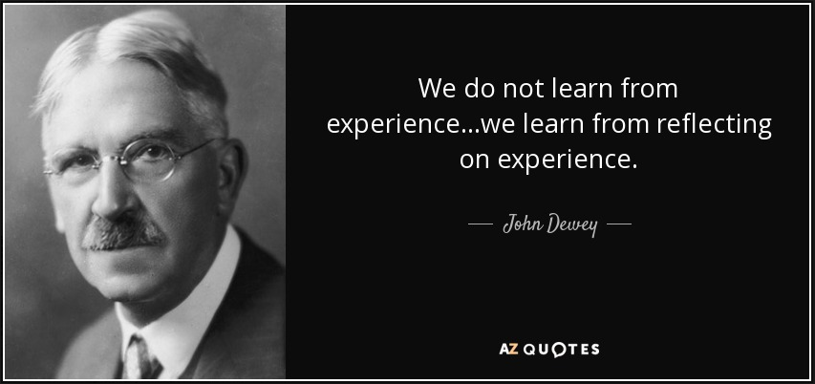
Reflecting
on Intercultural Competence
Why is reflection so important?
How can we prompt learners to reflect?
Should you be reflecting, too?

Slide 59
ICC ACTIVITY DESIGNS Reflecting on the Activity
DEBRIEFING
VS.
REFLECTING
In target language
Keep it concrete and specific
Compile and summarize what the whole class found – help them identify patterns
Point out connections to culture – what is cultural about this, not random or individual?
Make them talk, but steer toward the takeaways that you have in mind
In native language
Can ask questions that are too complex or abstract for their TL proficiency
Use multiple modes over time – speaking, writing, etc.
Encourage them to identify and describe how they used intercultural attitudes and skills
Return to these reflections later to show them their progress

Slide 60
Debriefing (Review of task in target language)
The class will summarize what they found by looking at how they used “tú” and any informal greetings and goodbyes and look at how they used “usted” (formal”) along with any formal greetings and goodbyes.
Then grade each dialogue individually once they finish their transcripts before they record on Flipgrid to ensure accuracy before presentational speaking.
Their dialogues and correct answers will depend on what two roles the students are writing the conversation as. (student/teacher, parent/child, etc)
Notes:
It's correct because the mom is addressing the son only using forms that come from the pronoun tú (estás, quieres)
The son is also using forms that only address his mom using usted (y usted?, tiene)

Slide 61
Reflection Prompts
Respond to the following questions in English:
1. Describe how students in Spanish speaking countries greet family, friends and teachers.
2. How is this similar and/or different from your way of greeting?
3. How comfortable or uncomfortable would you be using the appropriate greetings/good-byes in the target culture, with friends, family and teachers? Why do you think you would react this way?
4. How important would it be for you to adjust your behavior to fit in with teens in the target culture?
5. What do you think a Spanish teen would think about the way American students greet their friends, family and teachers? Do you think it would be hard for them to adjust their behavior?
6. What new insights about yourself and others have you gained from thinking about this?
Notes:
It's correct because the mom is addressing the son only using forms that come from the pronoun tú (estás, quieres)
The son is also using forms that only address his mom using usted (y usted?, tiene)

Slide 62
Who does the chores?
DOMESTIC DUTIES
See Corbett (2010)

Slide 63
ICC TASK BRAINSTORM
Choices & Steps |  | TASK DESIGN 1 |  | TASK DESIGN 2 |  | TASK DESIGN 3
CONTENT |  | Domestic Duties |  | Domestic Duties |  | Domestic Duties
STIMULI |  | Infographic from a magazine showing who typically does what chores
OBSERVATION |  |  |  |  |  | Watch a video and fill in a chart with chores and who does them when
APPLICATION |  |  |  | Interviews with adults about their chores
DEBRIEFING |  |  |  | Report back on content of interviews
REFLECTION

Slide 64
ICC ACTIVITY DESIGNS Cultural Content → Intercultural Activities
Theme | Discover | Adjust and Apply
Food | What foods are eaten on special occasions? Why? Observe: How and with whom do people interact in local cafés? | Design a new restaurant and menu that would be both authentic to the target culture* and appealing to your community.
Flags | What do the colors of target culture flags mean? Compare and contrast with the colors and design of your own flag. | Design a flag (or a mascot or a logo) that represents your class. Make a guide to local landmarks for peers from the TC.
Fashion | What is considered stylish for your peers in the target culture? Do your TC peers wear uniforms to school? Why? | Review clothing vocabulary. Then play a game: draw clothing items from a pile, and state where you would wear them. Ask a keypal: What would you wear to school? A party? An interview?
Famous People | Provide a list of famous people from the target culture. Students report on biography and counterparts in their own country. | Using the results of the investigation, debate: Which famous figures should be would be class president? Create a digital display of famous people to share with TC peers.
Family Life | What does a peer’s personal space look like in the TC? In different regions and socioeconomic levels? Compare. | Survey your peers and report results: Who does different chores in your home? What are your responsibilities? Compare and contrast with your classmates and then with a TC partner class.
Investigation: Interaction:

Slide 65
ICC ACTIVITY DESIGNS Cultural Themes → Intercultural Activities
Theme | Discover | Adjust and Apply
Food | What foods are eaten on special occasions? Why? Observe: How and with whom do people interact in local cafés? | Design a new restaurant and menu that would be both authentic to the target culture (TC) and appealing to your community.
Flags | What do the colors of target culture flags mean? Compare and contrast with the colors and design of your own flag. | Design a flag (or a mascot or a logo) that represents your class. Make a guide to local landmarks for peers from the TC.
Fashion | What is considered stylish for your peers in the target culture? Do your TC peers wear uniforms to school? Why? | Ask a keypal: What would you wear to school? A party? An interview?
Famous People | Provide a list of famous people from the target culture. Students report on biography and counterparts in their own country. | Using the results of the investigation, debate: Which famous figures should be would be class president? Create a digital display of famous people to share with TC peers.
Family Life | What does a peer’s personal space look like in the TC? In different regions and socioeconomic levels? Compare. | Survey your peers and report results: Who does different chores in your home? What are your responsibilities? Compare and contrast with your classmates and then with a partner class in the target culture.
Investigation: Interaction:

Slide 66
ICC TASK BRAINSTORM
Choices & Steps |  | TASK DESIGN 1 |  | TASK DESIGN 2 |  | TASK DESIGN 3
CONTENT |  | Domestic Duties |  | Domestic Duties |  | Domestic Duties
STIMULI |  | Infographic from a magazine showing who typically does what chores
OBSERVATION |  |  |  |  |  | Watch a video and fill in a chart with chores and who does them when
APPLICATION |  |  |  | Interviews with adults about their chores
DEBRIEFING |  |  |  | Report back on content of interviews
REFLECTION
Now write the
Reflection Prompts

Slide 67
Reflection Prompts
Knowledge Grows
I know more about...
Attitudes Adjust
I want to explore more about...
Skills Improve
Engage Yourself
I adjusted my attitudes about...
I got better at... Next time I will…
How would you frame the questions for your activity?
How much do the prompts need to change from one ICC activity to the next?

Slide 68
Knowledge
Attitudes
Skills
Engagement

Slide 69
Group 2
Knowledge
Attitudes
Skills
Engagement

Slide 70
Group 3
Knowledge
Attitudes
Skills
Engagement

Slide 71
AND THE CYCLE CONTINUES…
Critical Cultural Awareness
Skills of Interpreting and Relating
Skills of Discovery and Interaction
Attitudes
Cultural Knowledge
Adapted from Byram & Zarate (1997); Byram, Gribkova, & Starkey (2002)
Notes:
Keep

Slide 72
THANK YOU
What resonated with you?
What questions do you have?
Connect with us in person or online!
Twitter
LinkedIn
YouTube
Dr. Amanda Lanier | lanierlingvista.org

Slide 73
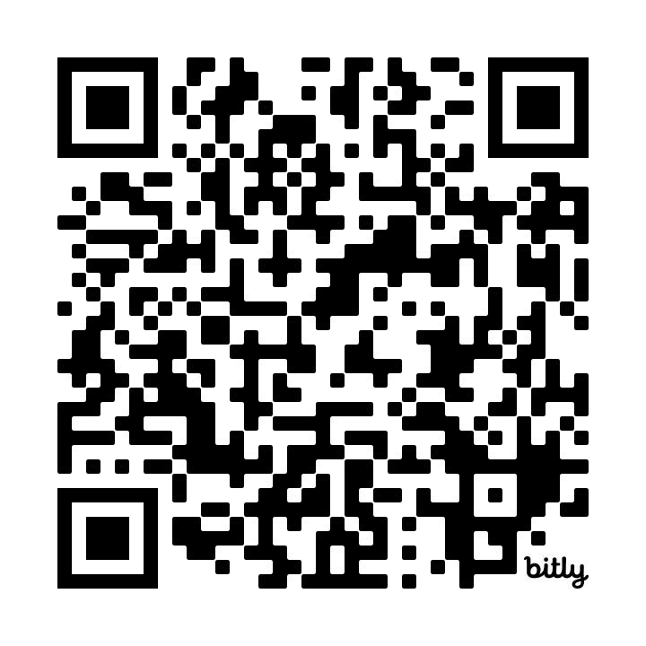
Thank you for participating in this session! Your feedback is valuable to both the presenters and the SCOLT Board. Please scan the QR code or access the bit.ly link to give feedback on this session.
https://bit.ly/SCOLT24SessionFeedback

Slide 74
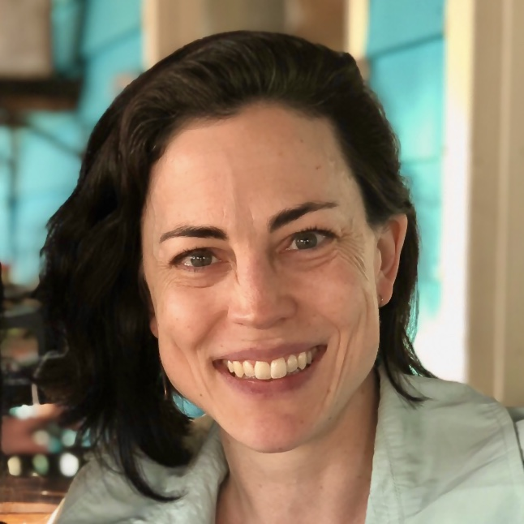
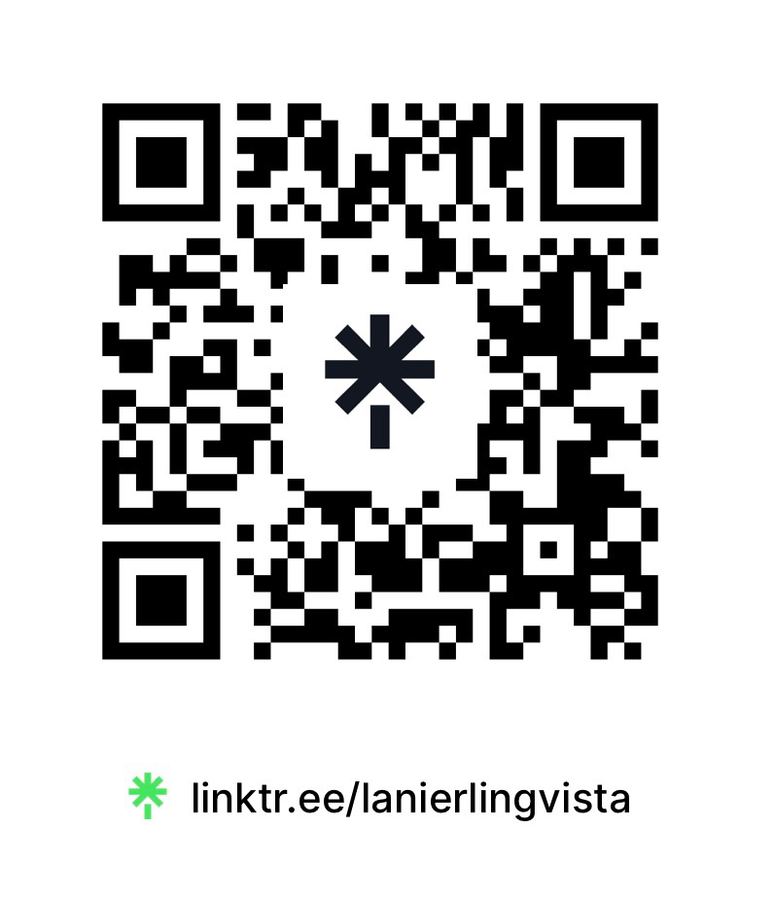
Presenter Bio
Dr. Amanda Lanier is an applied linguist with 20 years of experience in language teaching and 10 years in online learning and program administration. She is the Director of Michigan State University’s online graduate programs in Foreign Language Teaching, a project lead for professional development through the National Resource Center for Less-Commonly-Taught Languages (NLRC), and primary investigator on a multi-year study of collaboration and change in world language programs. Her work as a scholar and educator focuses on the intersections of language, identity, culture, and technology, particularly in regard to critical and heritage languages. She is trained as an actor, director, and musician, and she is studying her sixth language. Dr. Lanier shares resources, project updates, and past presentations on her website at: lanierlingvista.org.

Slide 75
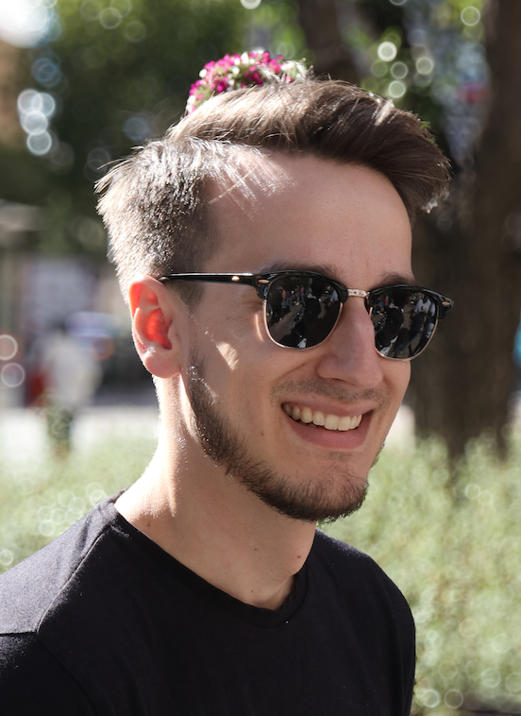
Presenter Bio
Mr. Michael Nunley is a High School Spanish teacher. He has been teaching Spanish for seven years, two in Indianapolis, Indiana and the other five in Decatur, Georgia. He recently graduated with his Masters in Foreign Language Teaching at Michigan State University.
Recently he led 50 students on a study abroad trip to Salamanca, Spain which became the impetus for his capstone project and this presentation.

Slide 76
USEFUL LINKS
Wakelet Collection:
Integrating Language and Culture
Amanda Lanier’s Website: Intercultural Competence in Language Teaching https://lanier.commons.msu.edu/icc-in-flt/
Wakelet Collection: Integrating Culture and Language https://wakelet.com/wake/qHVc8WwiO7fpLYIzmp__F
LinguaFolio Training Module 5: The Importance of Interculturality https://ncssfl.org/lfmodules/module5-0/
NCSSFL-ACTFL Can-Do Statements https://www.actfl.org/educator-resources/ncssfl-actfl-can-do-statements
Council of Europe: Autobiography of Intercultural Encounters https://www.coe.int/en/web/autobiography-intercultural-encounters
Global Competence https://asiasociety.org/education/global-competence

Slide 77
REFERENCES AND RESOURCES
Byram, M., & Zarate, G. (1997). Defining and assessing intercultural competence: Some principles and proposals for the European context. Language Teaching, 29(04), 239–243.
Corbett, J. (2010). Intercultural language activities. In S. Thornbury (Ed.), Cambridge handbooks for language teachers. Cambridge University Press.
Deardorff, D. K. (2006). Identification and assessment of intercultural competence as a student outcome of internationalization. Journal of Studies in International Education, 10(3), 241–266. https://journals-sagepub-com.proxy2.cl.msu.edu/doi/10.1177/1028315306287002
Deardorff, D. K. (Ed.). (2009). The Sage handbook of intercultural competence. Sage Publications, Inc.
Fantini, A. E. (2009). Assessing intercultural competence. In D. K. Deardorff (Ed.), The SAGE handbook of intercultural competence (pp. 456–476). SAGE Publications. https://us.sagepub.com/en-us/nam/the-sage-handbook-of-intercultural-competence/book232239
Hammer, M. R., Bennett, M. J., & Wiseman, R. (2003). Measuring intercultural sensitivity: The intercultural development inventory. International Journal of Intercultural Relations, 27(4), 421–443.
Kramsch, C. (1993). Context and culture in language teaching. Oxford University Press.
Lanier Temples, A. (2015). Language and identity. In J. M. Bennett (Ed.), The SAGE Encyclopedia of Intercultural Competence (pp. 574–578). SAGE Publications, Inc. http://dx.doi.org/10.4135/9781483346267
Liddicoat, A. J., & Scarino, A. (2013). Intercultural Language Teaching and Learning. Wiley-Blackwell. https://ebookcentral-proquest-com.proxy2.cl.msu.edu/lib/michstate-ebooks/detail.action?docID=1124313
Liddicoat, A., & Scarino, A. (2020). Assessing intercultural language learning. In J. Jackson (Ed.), The Routledge Handbook of Language and Intercultural Communication (pp. 395–410). Routledge. https://doi.org/10.4324/9781003036210-30
O’Dowd, R., & Dooly, M. (2020). Intercultural communicative competence development through telecollaboration and virtual exchange. In J. Jackson (Ed.), The Routledge Handbook of Language and Intercultural Communication (pp. 361–375). Routledge. https://doi.org/10.4324/9780203805640
Roy, P., Wandschneider, E., & Steglitz, I. (n.d.). Assessing education abroad outcomes: A review of the BEVI, IDI, and GPI. http://studyabroad.isp.msu.edu/research/
Scarino, A. (2009). Assessing intercultural capability in learning languages: Some issues and considerations. Language Teaching, 42(01), 67–80.
The Routledge handbook of language and intercultural communication. (2020). In J. Jackson (Ed.), The Routledge handbook of language and Intercultural Communication. Routledge. http://catalog.lib.msu.edu/record=b14303446~S39a
Wandschneider, E., et al. (2015). The Forum BEVI Project: Applications and Implications for International , Multicultural , and Transformative Learning. Frontiers: The Interdisciplinary Journal of Study Abroad, 25, 150–228.

Slide 78
Supplemental material
Frameworks and Templates

Slide 79
Intercultural Attitude Adjustments (Lanier, 2021)
File is available for your use
Creative Commons License
Attitudes are the filter through which other learning must pass.
Learners can develop these attitudes in language classes and apply them in many other contexts.

Slide 80
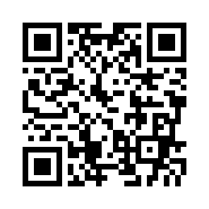
WAKELET COLLECTION: https://wakelet.com/wake/qHVc8WwiO7fpLYIzmp__F

Slide 81
KASE Rubric > Grading the Task
If doing the reflection in a group, also include credit for handling the group interaction well.
 | Criterion | Assessment Description (Desired Evidence)
 | Peer Interaction | Throughout this session, you interacted with your peers with respect, openness, and strategic competence. You contributed to the exchange of ideas (though you did not have to agree), avoided criticism or judgment of your peers as individuals, and helped move the conversation forward with questions and feedback. Your peers would be likely to feel comfortable with future opportunities to reflect with you. [Use if choosing Group response. Individual response assessments, delete this criterion or give points for task completion]

Slide 82
INTERCULTURAL COMPETENCE The Savoirs Framework - Council of Europe
Intercultural Competence for All (COE, 2012)
Cultural Knowledge
(savoirs)
Knowledge of social groups and their products and practices in one’s own and one’s interlocutor’s country, and of the general processes of societal and individual interaction.
Intercultural attitudes
(savoir être)
Curiosity and openness, readiness to suspend disbelief about other cultures and belief about one’s own. Willingness to relativise one’s own values, beliefs, and behaviours. Ability to “decentre”.
Skills of interpreting and relating
(savoir comprendre)
Ability to interpret a document or event from another culture, to explain it and relate it to documents or events from one’s own.
Skills of discovery and interaction
(savoir apprendre/faire)
Ability to acquire new knowledge of a culture and cultural practices and the ability to operate knowledge, attitudes and skills under the constraints of real-time communication and interaction.
Critical cultural awareness
(savoir s’engager)
Ability to evaluate, critically and on the basis of explicit criteria, perspectives, practices and products in one’s own and other cultures and countries.
Byram, Gribkova, & Starkey (2002); Liddicoat & Scarino (2013)
Notes:
Keep

Slide 83
INTERCULTURAL TASKS Planning Process
What products, practices, and/or perspectives do you want the task to involve?
Content
Stimuli
Observation
Application
Debriefing
Reflection
When and how will they reflect on the task? What growth in ICC attitudes and skills do you want to see in their reflections?
Such as: texts, videos, images, visitors, keypals, etc.
Mostly in L2
Can be in L1
What input will provide exposure to the products, practices, and/or perspectives?
How will the class summarize, report, and compare what they found? How will you know they have met the objectives?
In TBLT terms – this is a pre-task
In TBLT terms – this is the main task
What will you ask them to do with the stimuli? How will you assess comprehension of the stimuli?
What will they do in order to apply what they have learned and demonstrate their intercultural attitudes and skills?

