Slide 1
Opening Doors to
Global Opportunity:
Advocacy for Languages and Transferrable Skills
Central States 2026 – Chicago, IL
Languages are FUNdamental
Presented by Dr. Amanda Lanier
Michigan State University | alanier@msu.edu
lanierlingvista.org/program-administration/advocacy
Notes:
Perspectives on advocacy
Global opportunity
Transferrable skills
Pedagogy discussion
Directions from here

Slide 2
How many of you have heard…
I don’t think I’ll ever use my language skills in the future.
If I don’t learn another language, I won’t be able to get a job.
Language learning experience will make me a better job candidate.
The world desperately needs global citizens
with multilingual skills and intercultural competence.

Slide 3

If someone says humanities courses are unnecessary because they are
“soft skills,”
then ask them how well their computer would work
without software.

Slide 4
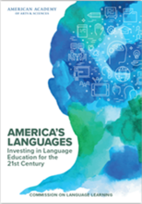
“Proficiency in English is not sufficient”
America’s Languages: Investing in Language Education for the 21st Century (2017)
There is an emerging consensus among leaders in business and politics, teachers, scientists, and community members that proficiency in English is not sufficient to meet the nation’s needs in a shrinking world, nor the needs of individual citizens who interact with other peoples and cultures more than at any other time in history. (p. viii)
https://www.amacad.org/publication/americas-languages

Slide 5
“What AI earbuds can’t replace:
The value of learning another language”
Interpersonally, using another’s language fosters both cultural and cognitive empathy.
In addition, the cognitive benefits of multilingualism are equally well documented: resistance to dementia, divergent thinking, flexibility in shifting attention, acceptance of multiple perspectives and explanations, and reduced bias in reasoning.
The very attributes companies seek in the AI age – resilience, lifelong learning, analytical and creative thinking, active listening – are all cultivated through language learning.
Guillén & Sawin (2025) in The Conversation
https://theconversation.com/what-ai-earbuds-cant-replace-the-value-of-learning-another-language-264965

Slide 6
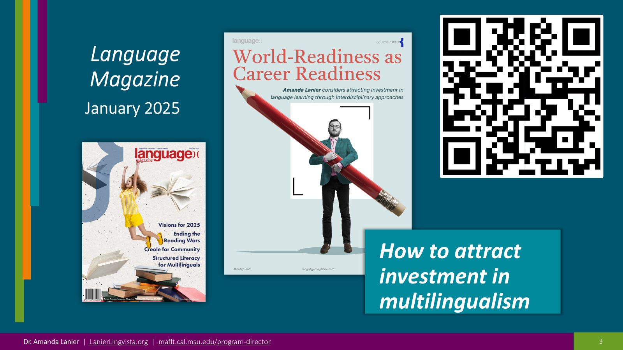

Slide 7
Why Advocate?

Slide 8
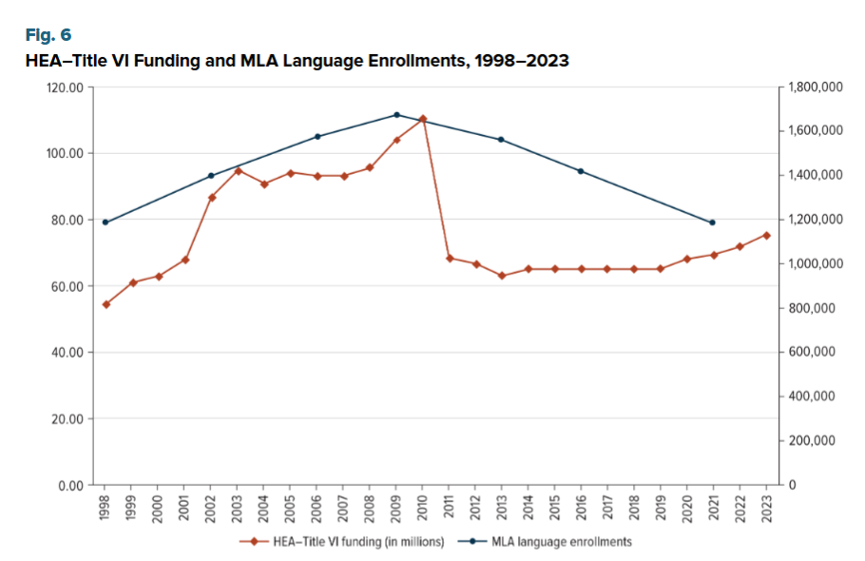
Language Enrollments Over Time vs.
HEA
Title VI Funding
Modern Language Association Enrollment Report
(Lusin, et al., 2023)
2009
Enrollments
2023
Funding
Decreases in funding and other support clearly correlate with decreases in enrollment, regardless of demand or need

Slide 9
Languages in U.S. Higher Ed
MLA Report (2023)
Less than 7% of U.S. college students are studying a language
Numbers include classical languages and American Sign Language
Enrollments in all of the
top 15 languages are decreasing except Korean

Slide 10

Language Advocacy Days 2025
Support reintroduction of proposals for:
World LEAP Act – primary FL programs (DoE)
BEST Act | Bilingual Education Seal and Teaching →
for Seal of Biliteracy
Sen. Paul Simon Study Abroad Act
Language Education Data Enhancement Act and AREA
Funding appropriation for existing programs:
WLARA | World Language Advancement and Readiness Grants (DoD funded)
NALRC | Native American Language Resource Center
Title III funding for Dual Language and Immersion
Title VI HEA/Fulbright-Hays support for Language Resource Centers and overseas educational programs
Join the America’s Languages Caucus
  Along with: Rep. Jen Kiggans (R-VA), Rep. Jimmy Panetta (D-CA), Sen. Shelley Moore Capito (R-WV), Sen. Brian Schatz (D-HI)

Slide 11

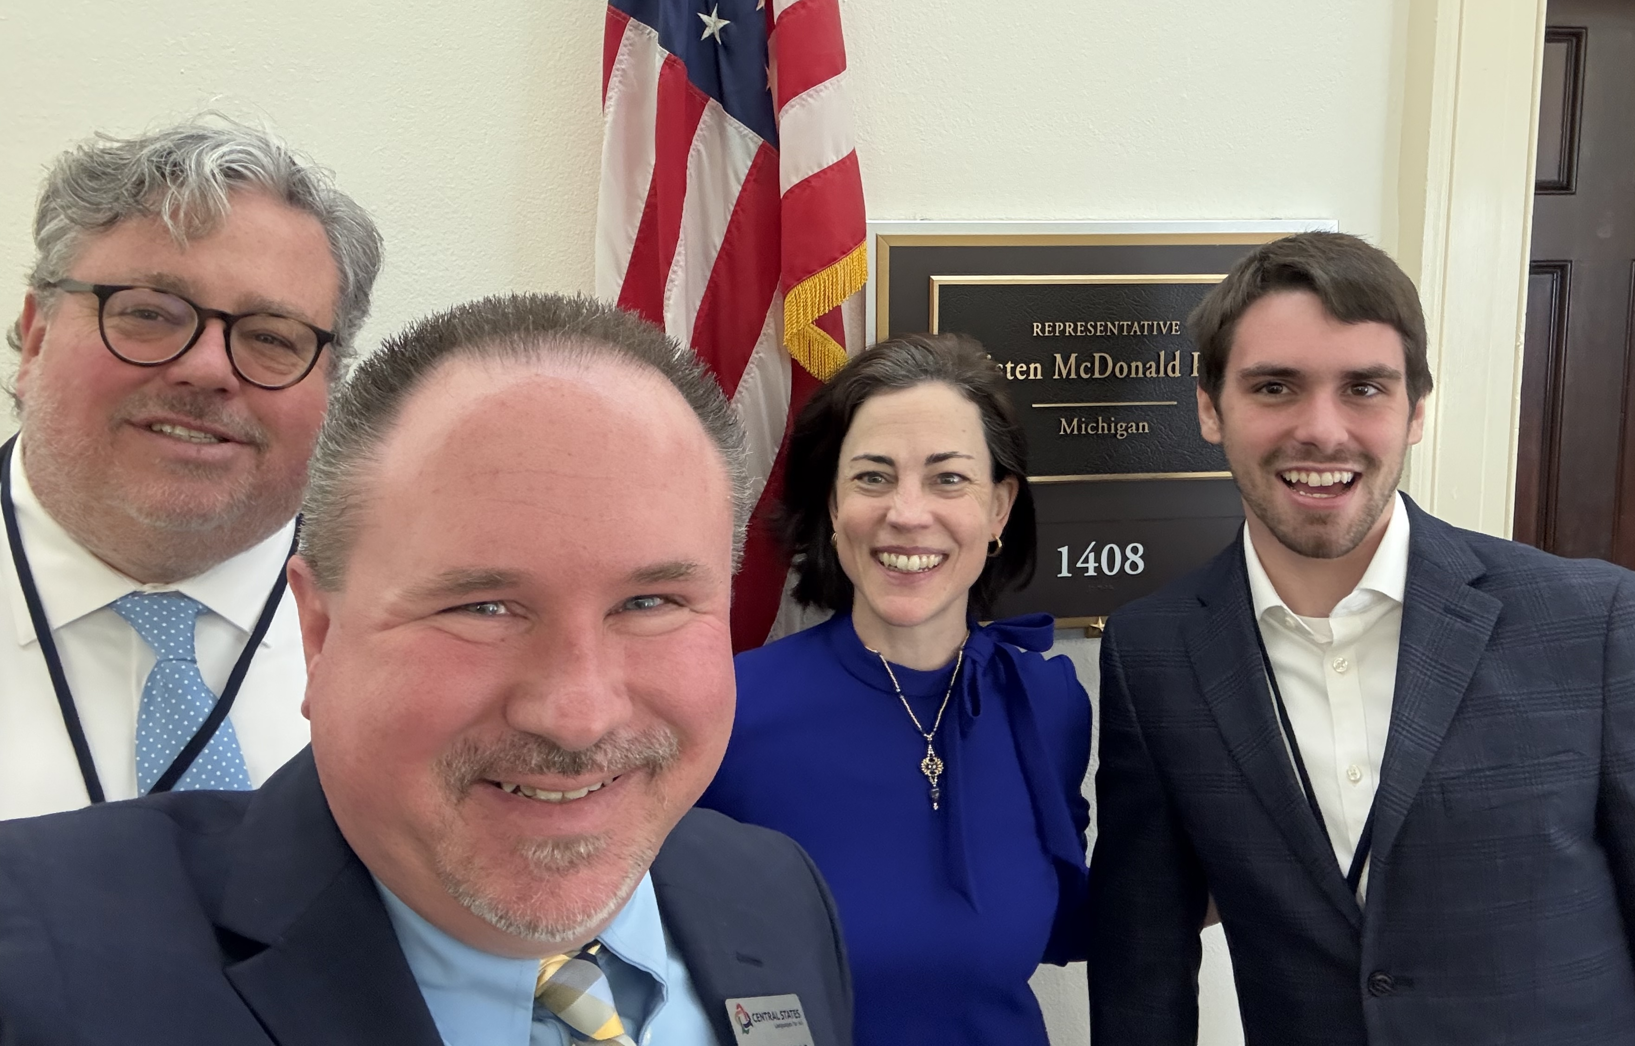
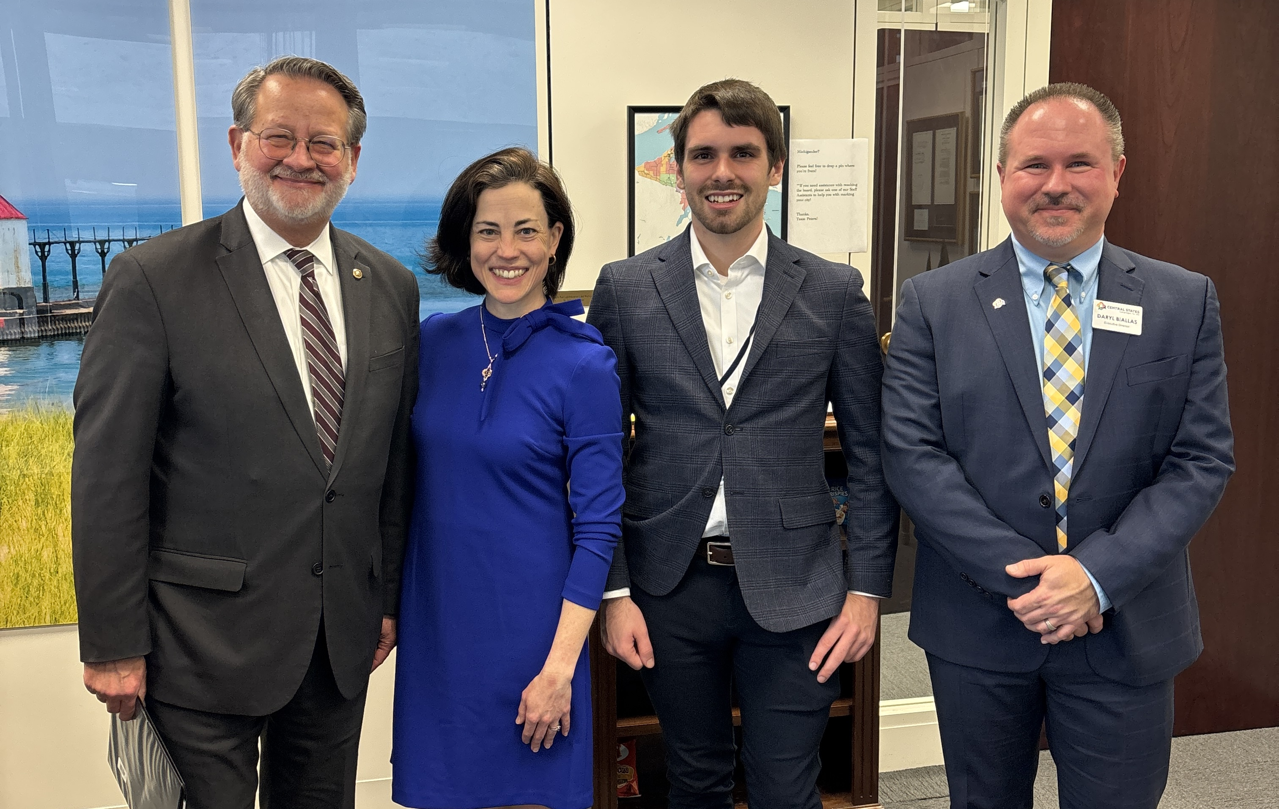
STATE REPORTS: SHARE YOUR SUCCESS
“Keep reaching out to us,” from Republicans as well as Democrats, even without
a specific promise, IS success.
Michigan
Messages that Resonated
  Education sector is only part of our story – this is relevant to staffers who cover workforce development, business investment, defense, etc.
  Seal of Biliteracy offers a valuable way to credential language proficiency – funding for assessments is essential
  HEA – Title VI funds make a big difference in enrollments and participation in higher ed language programs
  Top international trade partners for MI are Canada, Mexico, Brazil, China, etc. – we have bilingual speakers of those languages in MI, but not many programs for early start or immersion
  Employers value bilingual skills and communication skills – especially but not only in strategic languages
  We already have bipartisan support - Rep. Jen Kiggans as
  co-sponsor got attention in every office!
Good Questions and Requests from Staffers
Who are the co-sponsors? Who else is involved?
Is this new legislation, reintroduction, or an appropriation request?
Can I have more data on Seal of Biliteracy? Is it rewarding students
or teachers or both?
Which study abroad and K12 programs will be funded? Criteria?
How is this relevant to the Member’s other priorities? (e.g., veterans, tribal colleges, education in general, workforce, etc.
Our 2025 Team
Tony Grubbs | MSU
Daryl Biallas | Central States
Amanda Lanier | MSU & NLRC
Seth Killian | Lingco Language Labs
+ Julie Foss
SVSU & MIWLA
Photo Op with
Senator
Gary Peters
(D-MI)

Slide 12
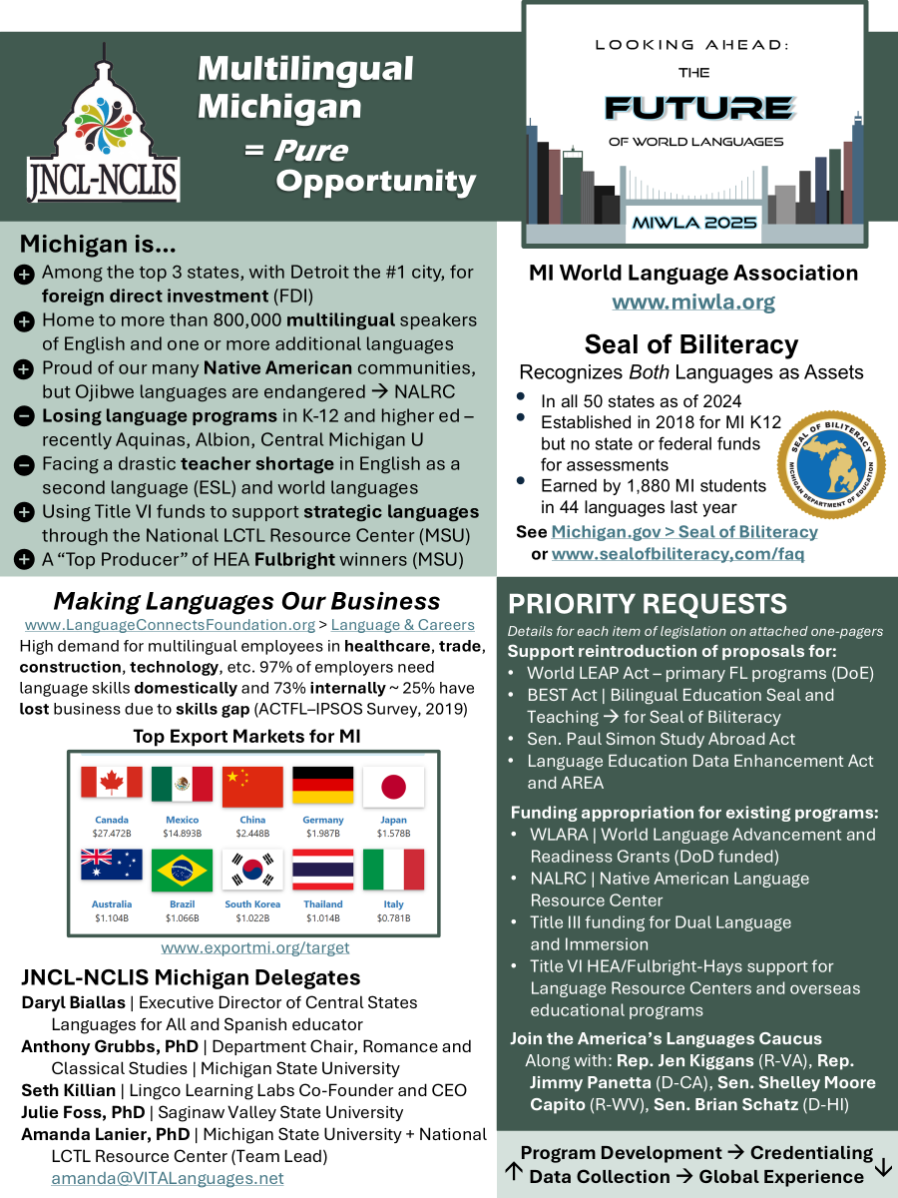
JNCL-NCLIS Language Advocacy Days – March 2025
Michigan one-pager for meetings with Congressional staff
Links on the one-pager:
Making Languages Our Business – Read the Report
http://www.languageconnectsfoundation.org
Top Export Markets for Michigan
http://www.exportmi.org/target
MIWLA > Advocacy Resources
https://www.miwla.org/about-miwla/advocacy-resources
Seal of Biliteracy – Michigan Resources
https://www.michigan.gov/mde/services/flexible-learning/michigan-seal-of-biliteracy

Slide 13
Aligning the Mission and Vision
Your vision is everyone’s vision! Do administrators know that?
“Michigan State’s early leaders responded to rapid changes in the mid-19th century and society’s needs by creating a new approach to education. Today’s issues are no less pressing: unprecedented technological advances reshaping work and nearly every other aspect of life; widening economic and social inequities; global health crises and climate/environmental emergencies. Such urgent concerns require the talents and gifts of all, making it vital for institutions to take bold steps toward diversity, equity and inclusion… [and] to be leaders in creating opportunities for tomorrow.”
https://strategicplan.msu.edu/mission#landgrant

Slide 14
Career Competencies

Slide 15

Career Competences that Employers Seek
Self-Development
Leadership
Communication
Professionalism
Critical Thinking
Teamwork
Equity & Inclusion
Technology
https://www.naceweb.org/career-readiness/
competencies/career-readiness-defined

Slide 16
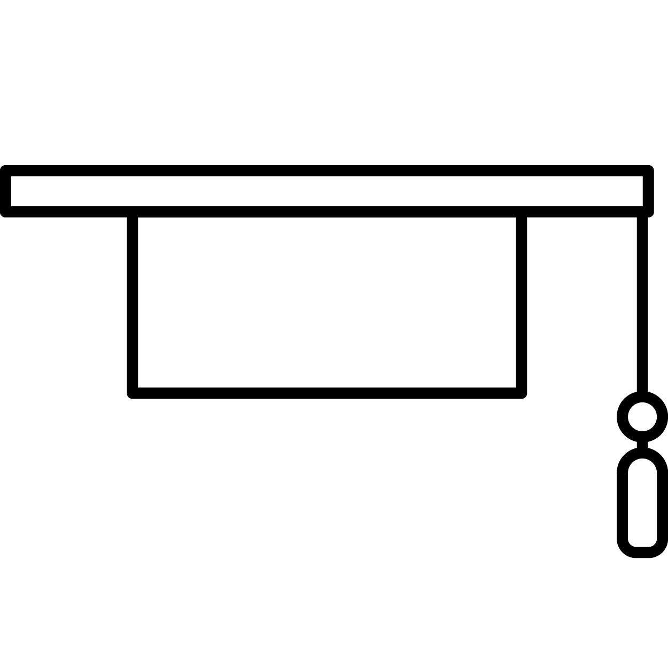







NACE Career Competencies
https://www.naceweb.org/career-readiness-competencies
Career & Self-Development
Awareness of Strengths and Challenges
Professional Development
Networking
Communication
Oral communication
Written communication
Non-verbal communication
Active listening
Critical Thinking
Display situational awareness
Gather & analyze data
Make effective & fair decisions
Equity & Inclusion
Engage multiple perspectives
Use inclusive & equitable practices
Advocate
Leadership
Inspire, persuade, & motivate
Engage various resources and seek feedback
Facilitate group dynamics
Professionalism
Act with integrity
Demonstrate dependability
Achieve goals
Teamwork
Build relationships for collaboration
Respect diverse perspectives
Integrate strengths
Technology
Leverage technology
Adapt to new technologies
Use technology ethically

Slide 17
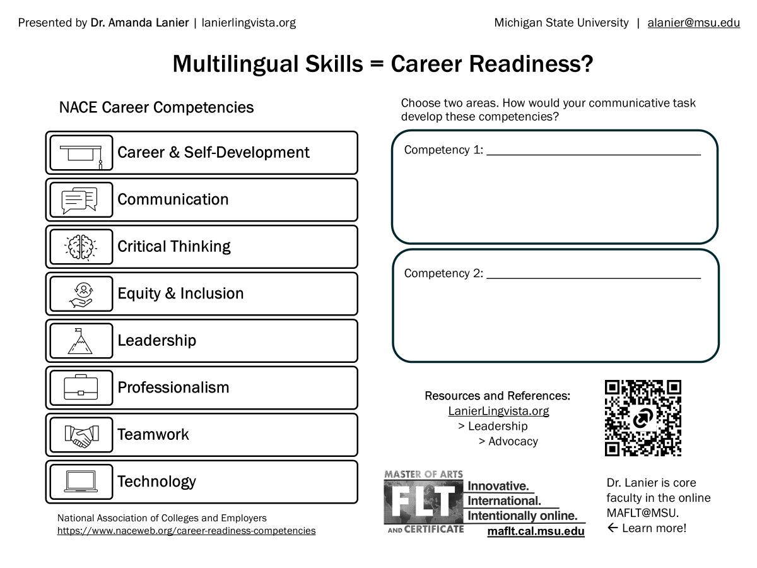

Slide 18
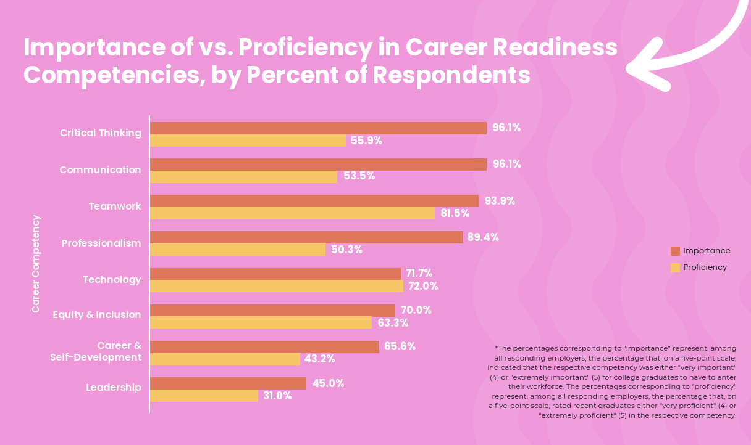
Importance of Competencies vs. Proficiency
Do recent graduates have the competencies that employers are looking for?
Biggest gaps:
Communication
Critical Thinking
Professionalism
Smallest gap:
Technology
Lowest readiness:
Leadership

Slide 19
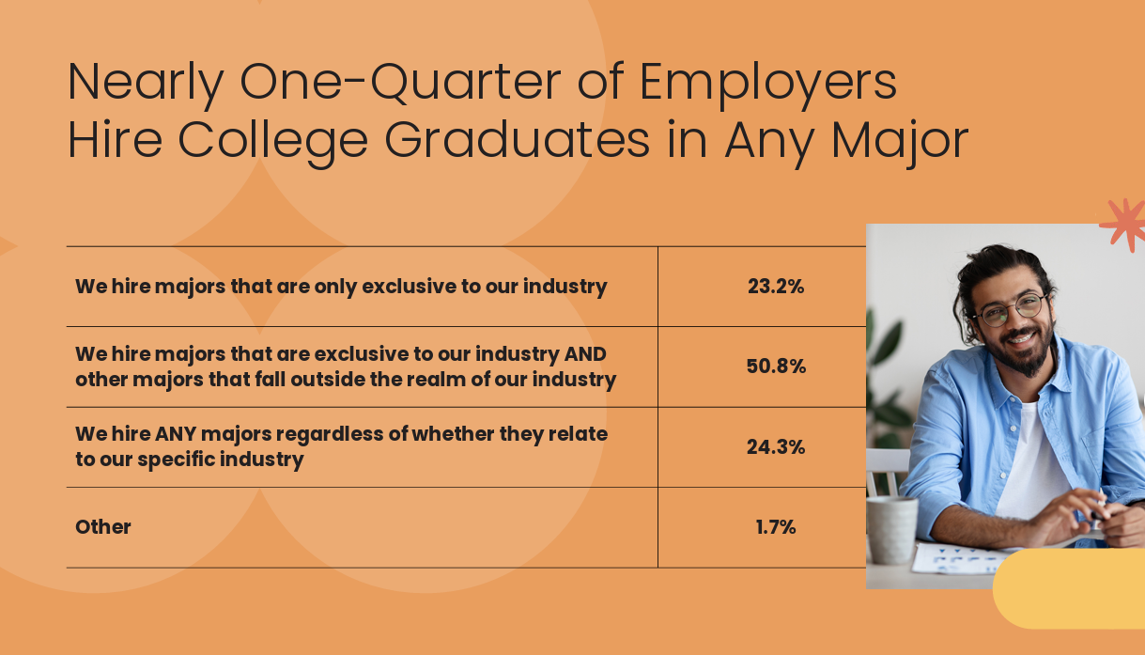
Importance of Your Major for Getting a Job
… but only 23% ONLY hire majors from their own industry
The other > 50% are flexible and looking at other factors

Slide 20
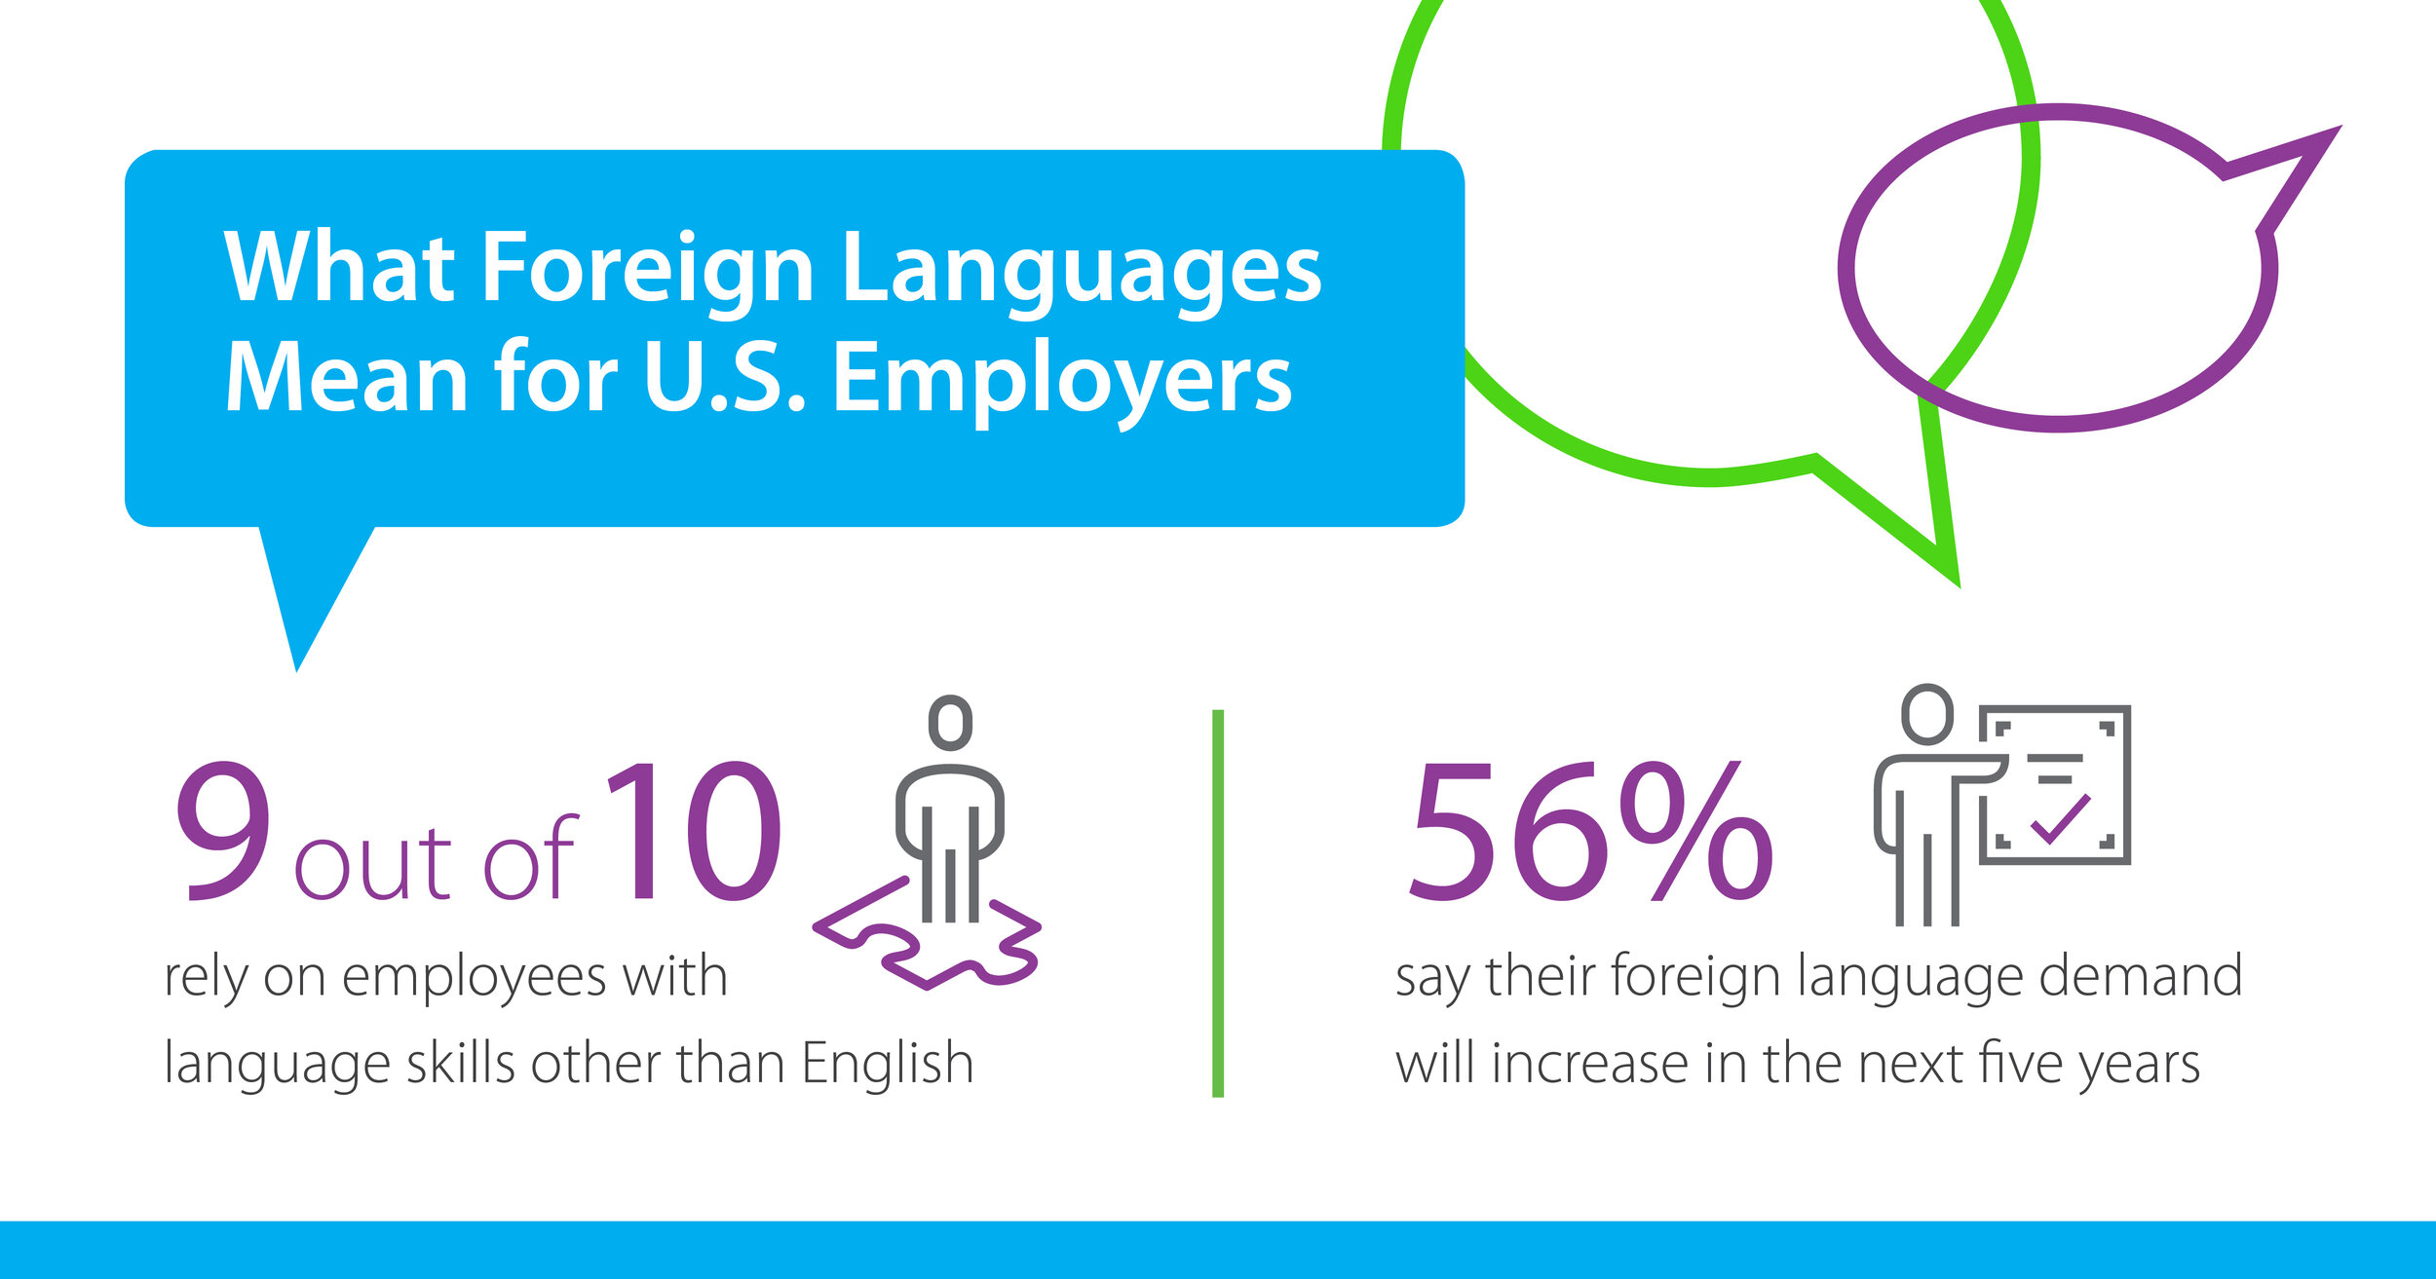
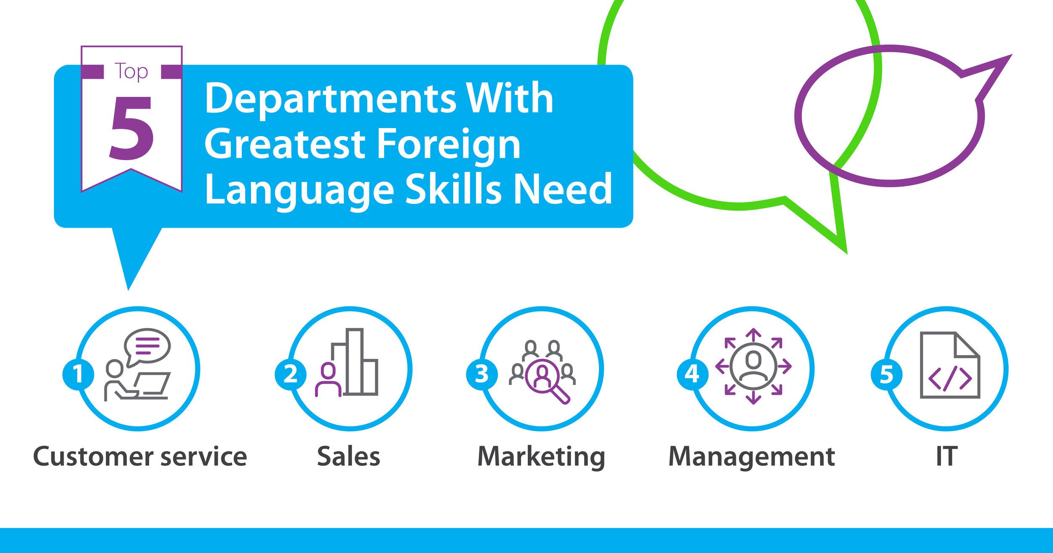
Importance of Languages for the Economy
Employers rely on multilingual workforce
Health care
Construction
Hospitality
Manufacturing
And many other industries!
From Making Languages Our Business (ACTFL, 2019)
www.languageconnectsfoundation.org/programs-initiatives/research/making-languages-our-business

Slide 21
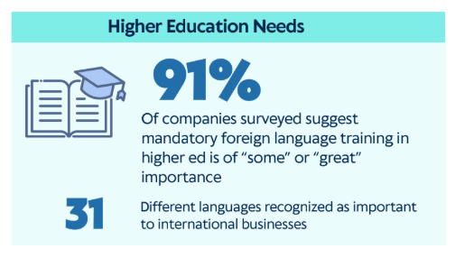
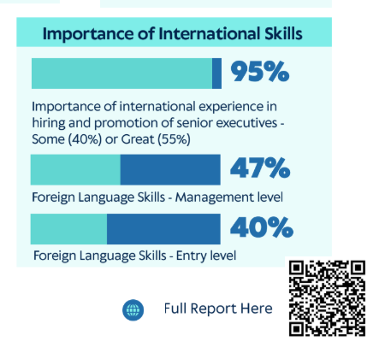
Importance of Language Skills for Jobs
Do employers value world language learning and multilingualism?
AIBER Report (2025) www.languagepolicy.org/advocacy-resources

Slide 22

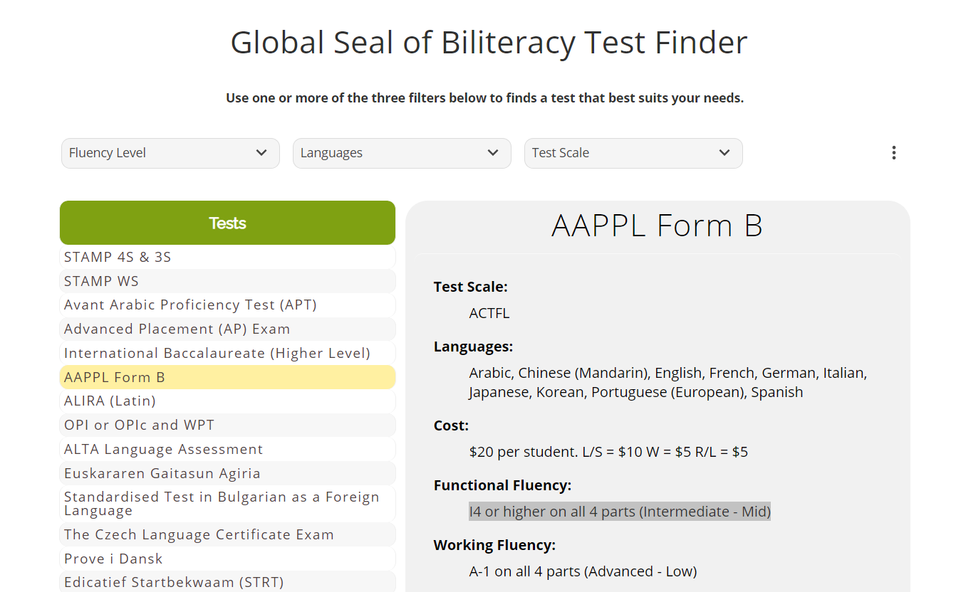
Importance of Credentials
Any level of proficiency can be valuable… but how are you demonstrating and documenting it?
Seal of Biliteracy
Recognizes Both Languages as Assets
Active in all 50 states as of 2024
Established in 2018 for MI public schools
Earned by 1,880 MI students in 44 languages last year
Only active in 17% of MI districts
SoBL and relevant assessments are recognized by many colleges for credit
Test Finder
theglobalseal.com
See Michigan.gov > Seal of Biliteracy
or www.sealofbiliteracy,com/faq

Slide 23
Cultivating Career Competencies
Consider one of our presentational tasks – which competences would it develop? How?
Career & Self-Development
Awareness of Strengths and Challenges
Professional Development
Networking
Communication
Oral communication
Written communication
Non-verbal communication
Active listening
Critical Thinking
Display situational awareness
Gather & analyze data
Make effective & fair decisions
Equity & Inclusion
Engage multiple perspectives
Use inclusive & equitable practices
Advocate
Leadership
Inspire, persuade, & motivate
Engage various resources and seek feedback
Facilitate group dynamics
Professionalism
Act with integrity
Demonstrate dependability
Achieve goals
Teamwork
Build relationships for collaboration
Respect diverse perspectives
Integrate strengths
Technology
Leverage technology
Adapt to new technologies
Use technology ethically

Slide 25
Intercultural & Global Competence

Slide 26

CULTIVATE THE OPPORTUNITY TO COMMUNICATE
“With your help, the ineffectual methods of the past will be replaced with real language learning.
All of our students should have the opportunity to graduate from our schools with the ability to communicate in another language”
(Ritz, 2021, p. 11).
Dr. Amanda Lanier | MSU MAFLT Program | LanierLingvista.org

Slide 27
INTERCULTURAL COMPETENCE
Cyclical process of development over time:
“It is more important to study culture as a process in which learners engage rather than as a closed set of information that he/she will be required to recall.”
(Liddicoat & Scarino, 2013, p. 23)
Learning involves “a set of processes through which intercultural learners pass many times as they develop greater complexity of understanding.”
(Liddicoat & Scarino, 2013, p. 59)
Noticing
Interacting
Comparing
Reflecting

Slide 28
DEVELOPING ICC
Cultural or Intercultural?
CULTURAL KNOWLEDGE
CROSS-CULTURAL EXPERIENCE
INTERCULTURAL SKILLS
How will that experience lead to intercultural skills?
What stimuli will I provide so they can experience that content?
INTERCULTURAL ATTITUDES
What content will be the foundation?
Are they demonstrating intercultural attitudes?

Slide 29
Global Changes and Challenges
Boix Mansilla and Jackson (2011) list “three forces shaping lives on the planet” (p. 1):
What issues matter for your learners?
Global Context
Local Context
Institutional Context
Classroom Context
the flattened global economy and changing demands of work;
unprecedented global migration and the changing nature of neighborhoods, identities, and citizenship; and
climate instability and the growing need for global environmental stewardship.

Slide 30
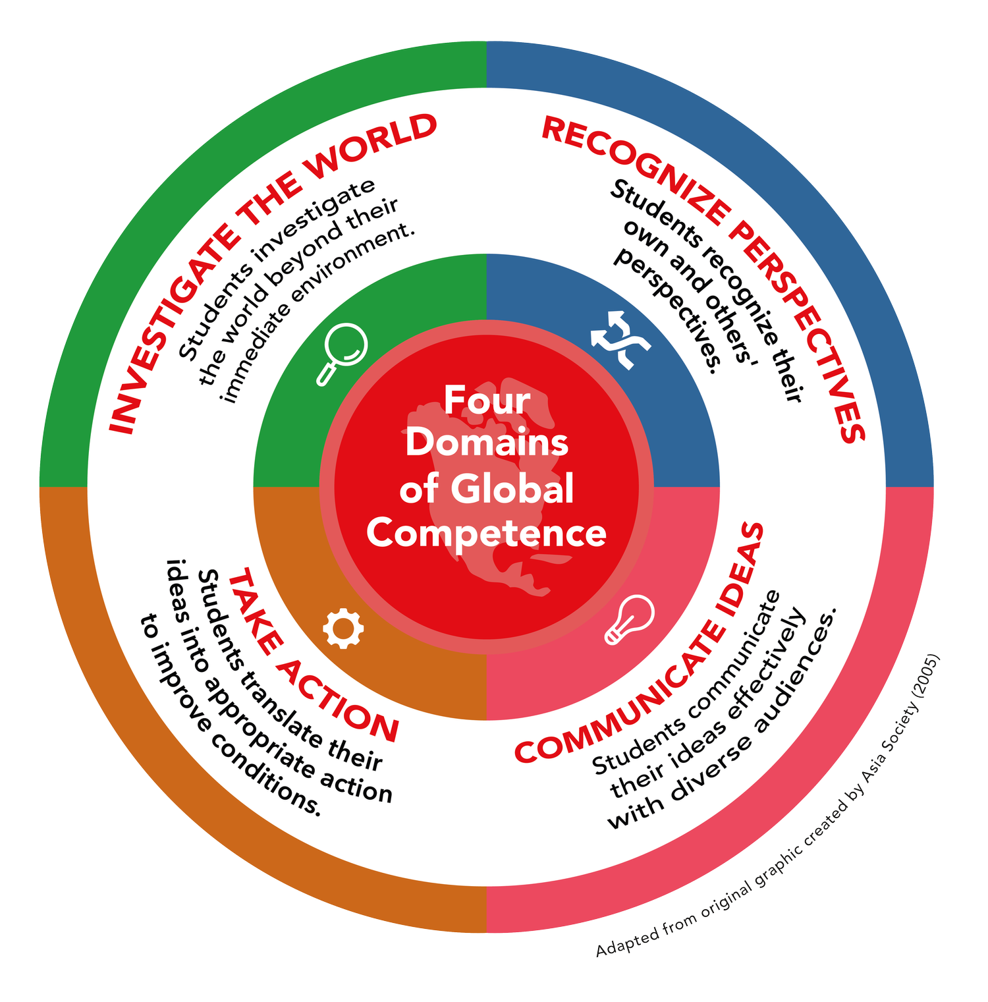
Global Competence
Globally competent individuals can…
Investigate the world
Investigate the world beyond their immediate environment, framing significant problems and conducting well-crafted and age-appropriate research.
Recognize varying perspectives
Recognize perspectives, others’ and their own, articulating and explaining such perspectives thoughtfully and respectfully.
Communicate effectively
Communicate ideas effectively with diverse audiences, bridging geographic, linguistic, ideological, and cultural barriers.
Take action to improve
Take action to improve conditions, viewing themselves as players in the world and participating reflectively.
Internationally recognized framework for developing global citizens
(Boix Mansilla & Jackson, 2011, p. 11)

Slide 31

United Nations
Sustainable Development Goals
(SDGs)

Slide 32
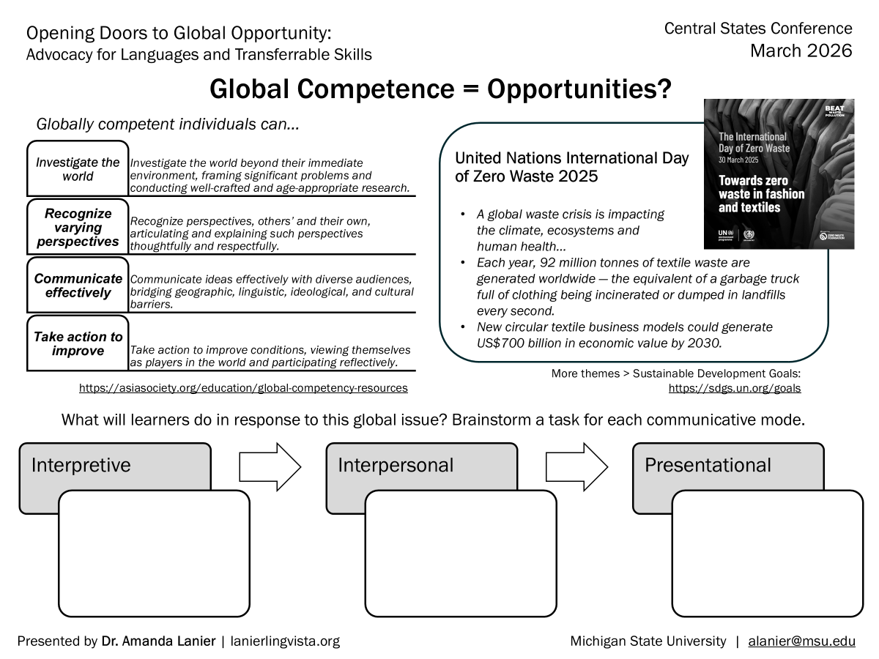

Slide 33
Meaningful, Purposeful Tasks

Slide 34
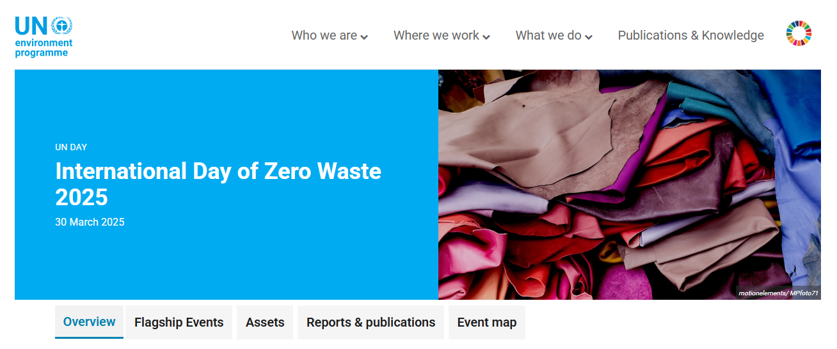
Lesson Plans with Global Reach
Dressing to Kill… the Environment
United Nations International
Day of Zero Waste 2025
> Towards zero waste in
fashion and textiles
https://www.unep.org/events/un-day/international-day-zero-waste-2025
What can learners do with this topic…
At different proficiency levels?
In all the communicative modes?
With content relevant to their target language and cultures?
https://sdgs.un.org/goals
A global waste crisis is impacting the climate, ecosystems and human health…
Each year, 92 million tonnes of textile waste are generated worldwide — the equivalent of a garbage truck full of clothing being incinerated or dumped in landfills every second.
New circular textile business models could generate US$700 billion in economic value by 2030.
Notes:
https://www.un.org/en/observances/zero-waste-day
https://www.unep.org/events/un-day/international-day-zero-waste-2025
UN Video: https://youtu.be/0v7f0KeNpv8?si=Oou0leaiR4U1iIMb
BBC Video: https://youtu.be/7i0QMnz4ExY?si=jiXs3XsAkE-hzpCW

Slide 36
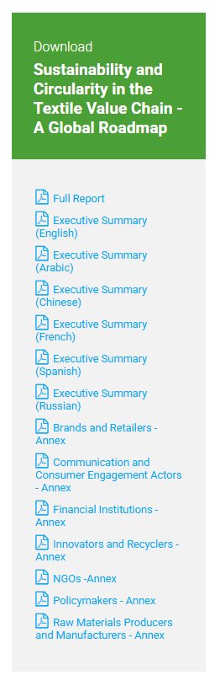
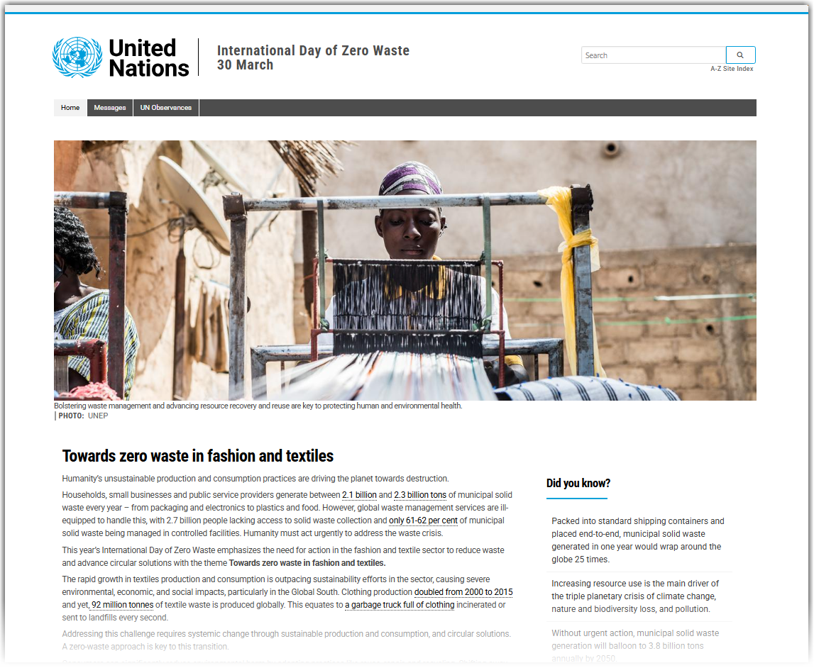
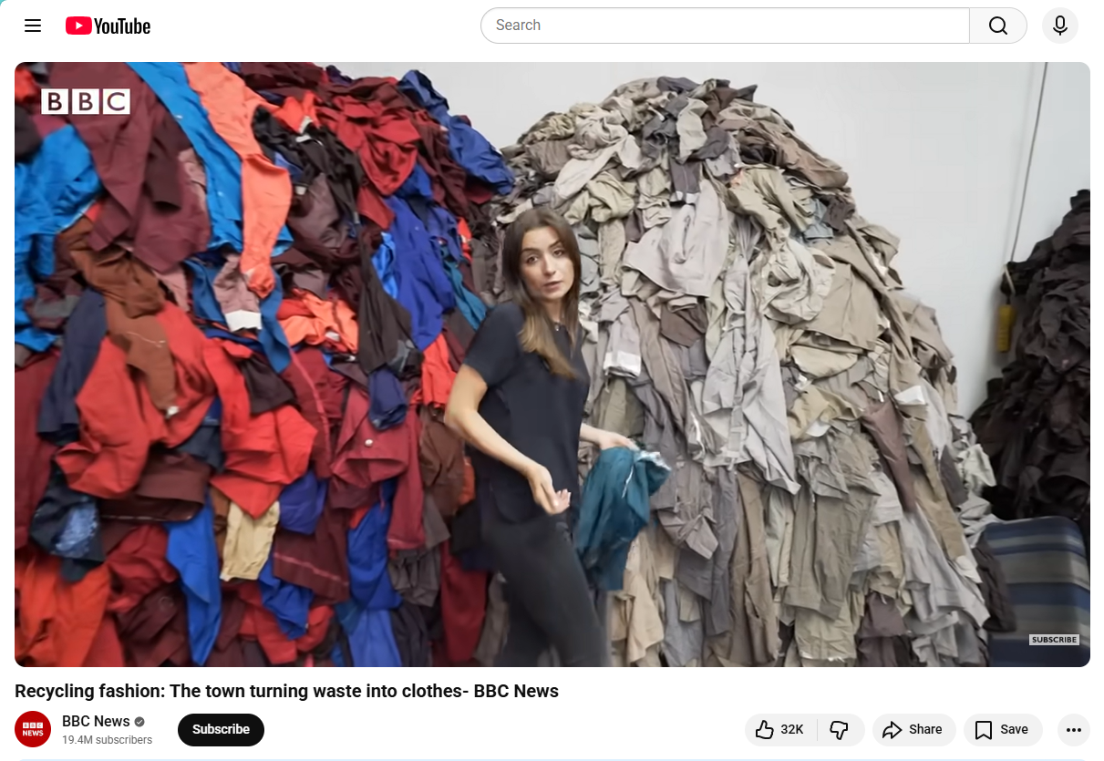
Lesson Plans > Stimuli
UN website, news articles, videos, photos, podcasts, real clothing

Slide 37
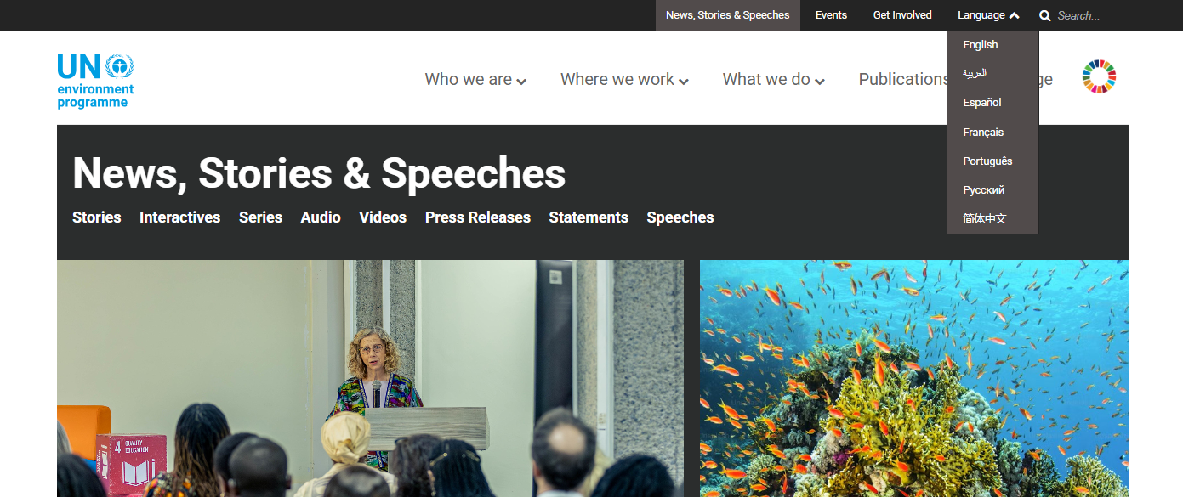
Lesson Plans > Interpretive Reading
I can..
Answer questions such as:
What was the 2025 theme of UN Zero Waste Day?
Why is fashion a problem for the environment?
Gather topic-specific language:
“fast fashion”
“reduce, reuse, recycle”
Waste, wasteful, wasted
Pollute, pollution, pollutant
Sustainable solutions
More critical thinking, e.g.,:
Find as many solutions in the text as you can – combine your list with peers’ lists – put the lists in order from possible to impossible
Find out about impact of “fast fashion” in your local area

Slide 38
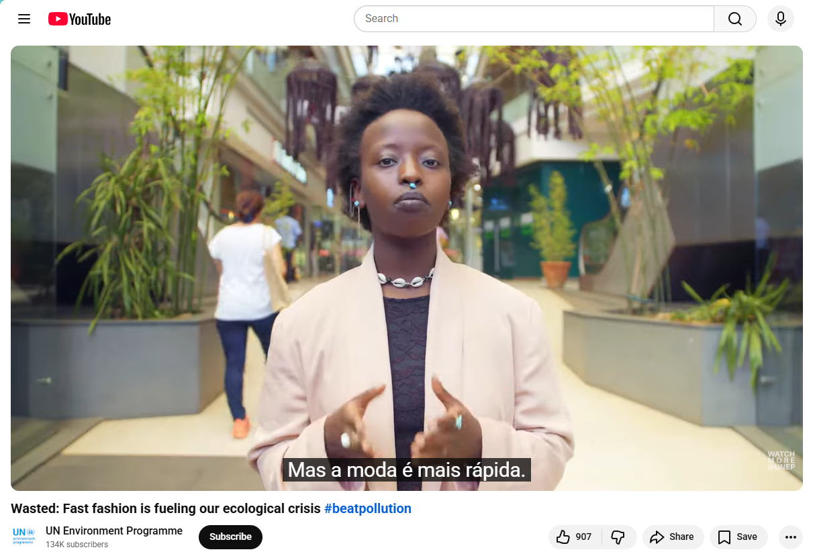
Lesson Plan > Interpersonal Speaking
I can..
Do you support fast fashion?
Questionnaire about how long we keep clothing, recycling clothing, wearing used clothing
Brief interviews
“Is your fashion
fast or slow? Why?”
Notes:
Be thoughtful about socioeconomic disparities in your classroom! Avoid asking questions like, “How often do you buy clothes?” or “How much do you spend on clothes in a year?” Wearing used clothes, keeping clothes a long time, repurposing fabric, etc. will be framed as positive for everyone.

Slide 39
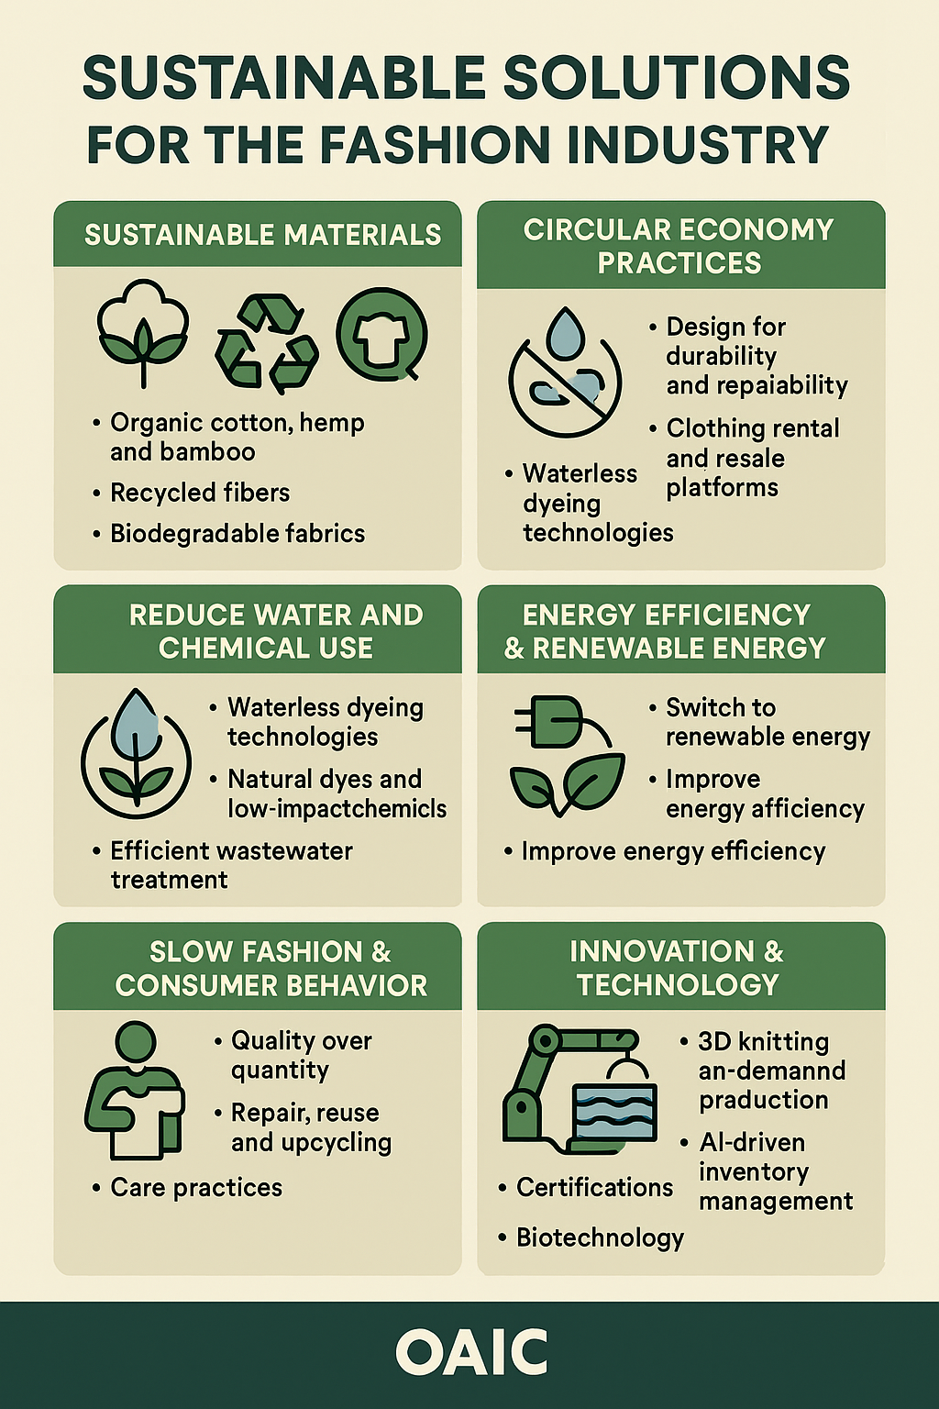
Lesson Plan > Presentational Writing
I can..
Create an infographic about the environtmental harm of fast fashion OR about sustainable solutions
Created by Microsoft CoPilot (generative AI)
Notes:
AI can generate the infographic, but students still have to come up with the content, review what the AI produces, and improve it (can ask them to turn in their prompt and at least two responses)

Slide 40
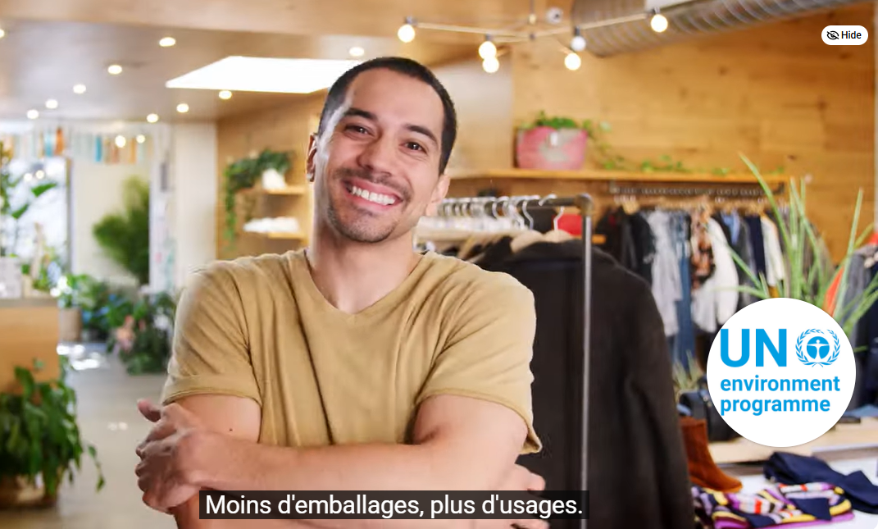
Lesson Plan > Presentational Speaking
I can..
Plan and deliver a presentation that persuades their peers to take the steps they can to reduce fashion waste

Slide 41
NACE Career Competencies
https://www.naceweb.org/career-readiness-competencies
Career & Self-Development
Awareness of Strengths and Challenges
Professional Development
Networking
Communication
Oral communication
Written communication
Non-verbal communication
Active listening
Critical Thinking
Display situational awareness
Gather & analyze data
Make effective & fair decisions
Equity & Inclusion
Engage multiple perspectives
Use inclusive & equitable practices
Advocate
Leadership
Inspire, persuade, & motivate
Engage various resources and seek feedback
Facilitate group dynamics
Professionalism
Act with integrity
Demonstrate dependability
Achieve goals
Teamwork
Build relationships for collaboration
Respect diverse perspectives
Integrate strengths
Technology
Leverage technology
Adapt to new technologies
Use technology ethically

Slide 43
Advocate for All the Humans

Slide 44

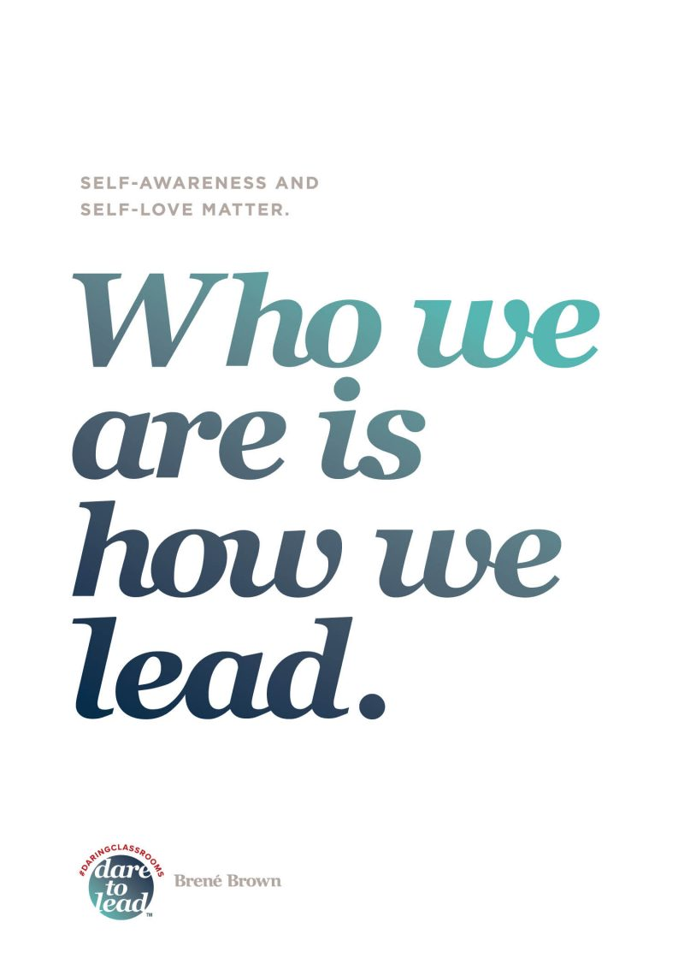

We Have Important Work to Do

Slide 45




THANKS FOR PARTICIPATING!
Dr. Amanda Lanier
https://lanierlingvista.org/latest-posts
Core Faculty
MA in Foreign Language Teaching
maflt.cal.msu.edu
Want to
follow up?
alanier@msu.edu
or LinkedIn

Slide 46
REFERENCES AND RESOURCES
Boix Mansilla, V., & Jackson, A. (2023). Educating for global competence: Preparing our students to engage the world (2nd ed.). ACSD. https://www.ascd.org/books/educating-for-global-competence-2nd-edition?variant=120024
Byram, M., & Zarate, G. (1997). Defining and assessing intercultural competence: Some principles and proposals for the European context. Language Teaching, 29(04), 239–243.
Commission on Language Learning. (2017). America’s languages: Investing in language education for the 21st century. American Academy of Arts & Sciences. https://doi.org/10.1353/hpn.2018.0003
Guillén, G., & Sawin, T. (2025, November 10). What AI earbuds can’t replace: The value of learning another language. https://doi.org/10.64628/AAI.ada4sc7vx
Lanier, A. (2025, January). World readiness as career readiness: Attracting investment in language education through interdisciplinary approaches. Language Magazine, 27–32. https://languagemagazine.com/2025/02/13/world-readiness-as-career-readiness/
Liddicoat, A. J., & Scarino, A. (2013). Intercultural Language Teaching and Learning. Wiley-Blackwell. https://ebookcentral-proquest-com.proxy2.cl.msu.edu/lib/michstate-ebooks/detail.action?docID=1124313
National Association of Colleges and Employers. (2025). NACE: What is Career Readiness? NACEweb.Org. https://www.naceweb.org/career-readiness/competencies/career-readiness-defined

Slide 47


USEFUL LINKS
Joint National Committee for Languages (JNCL-NCLIS)
www.languagepolicy.org/advocacy-resources
Language Connects Foundation
www.languageconnectsfoundation.org
National Association of Colleges and Employers
www.naceweb.com
Global Competence
asiasociety.org/education/global-competence
On my website:
  Advocacy
  lanierlingvista.org/program-administration/advocacy
  Intercultural Competence
  lanierlingvista.org/language-teaching/icc-in-flt

Slide 48
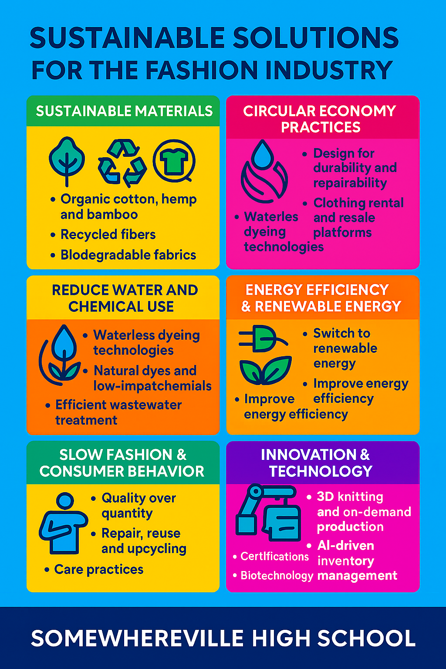
With AI Assistance
CoPilot prompt:
What impact does the clothing industry have on the global environment?
Response:
List with 8 domains, summary, and links to sources
“Would you like me to create a visual infographic summarizing these solutions?”

Slide 49



Slide 50

Global Competence
From Howard Gardner’s preface to 2011 edition:
What is needed more than ever is a laser-like focus on the kinds of human beings that we are raising and… the kind of world society that we are fashioning...
[My colleagues and I] have been studying what makes good persons, good workers, and good citizens…
As educators, we must model these positive virtues ourselves…
If we are to have a globe worth inhabiting, we must attend unflinchingly to the kinds of human beings that will inhabit it, and the ways in which they deal with one another under often trying circumstances.
(Boix Mansilla & Jackson, 2011, p. xi-xii)
Notes:
Resources: Asia Society () and OECD ()

Slide 51
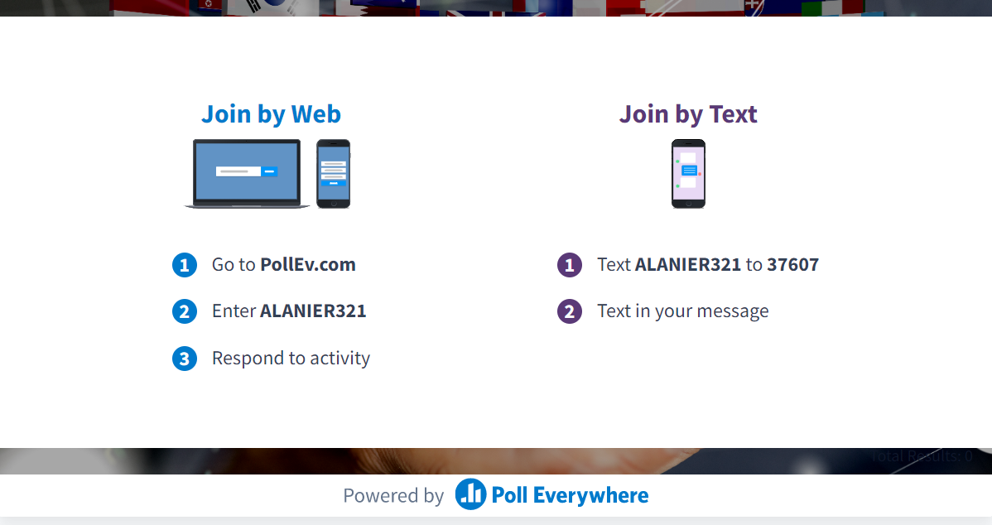

Slide 52


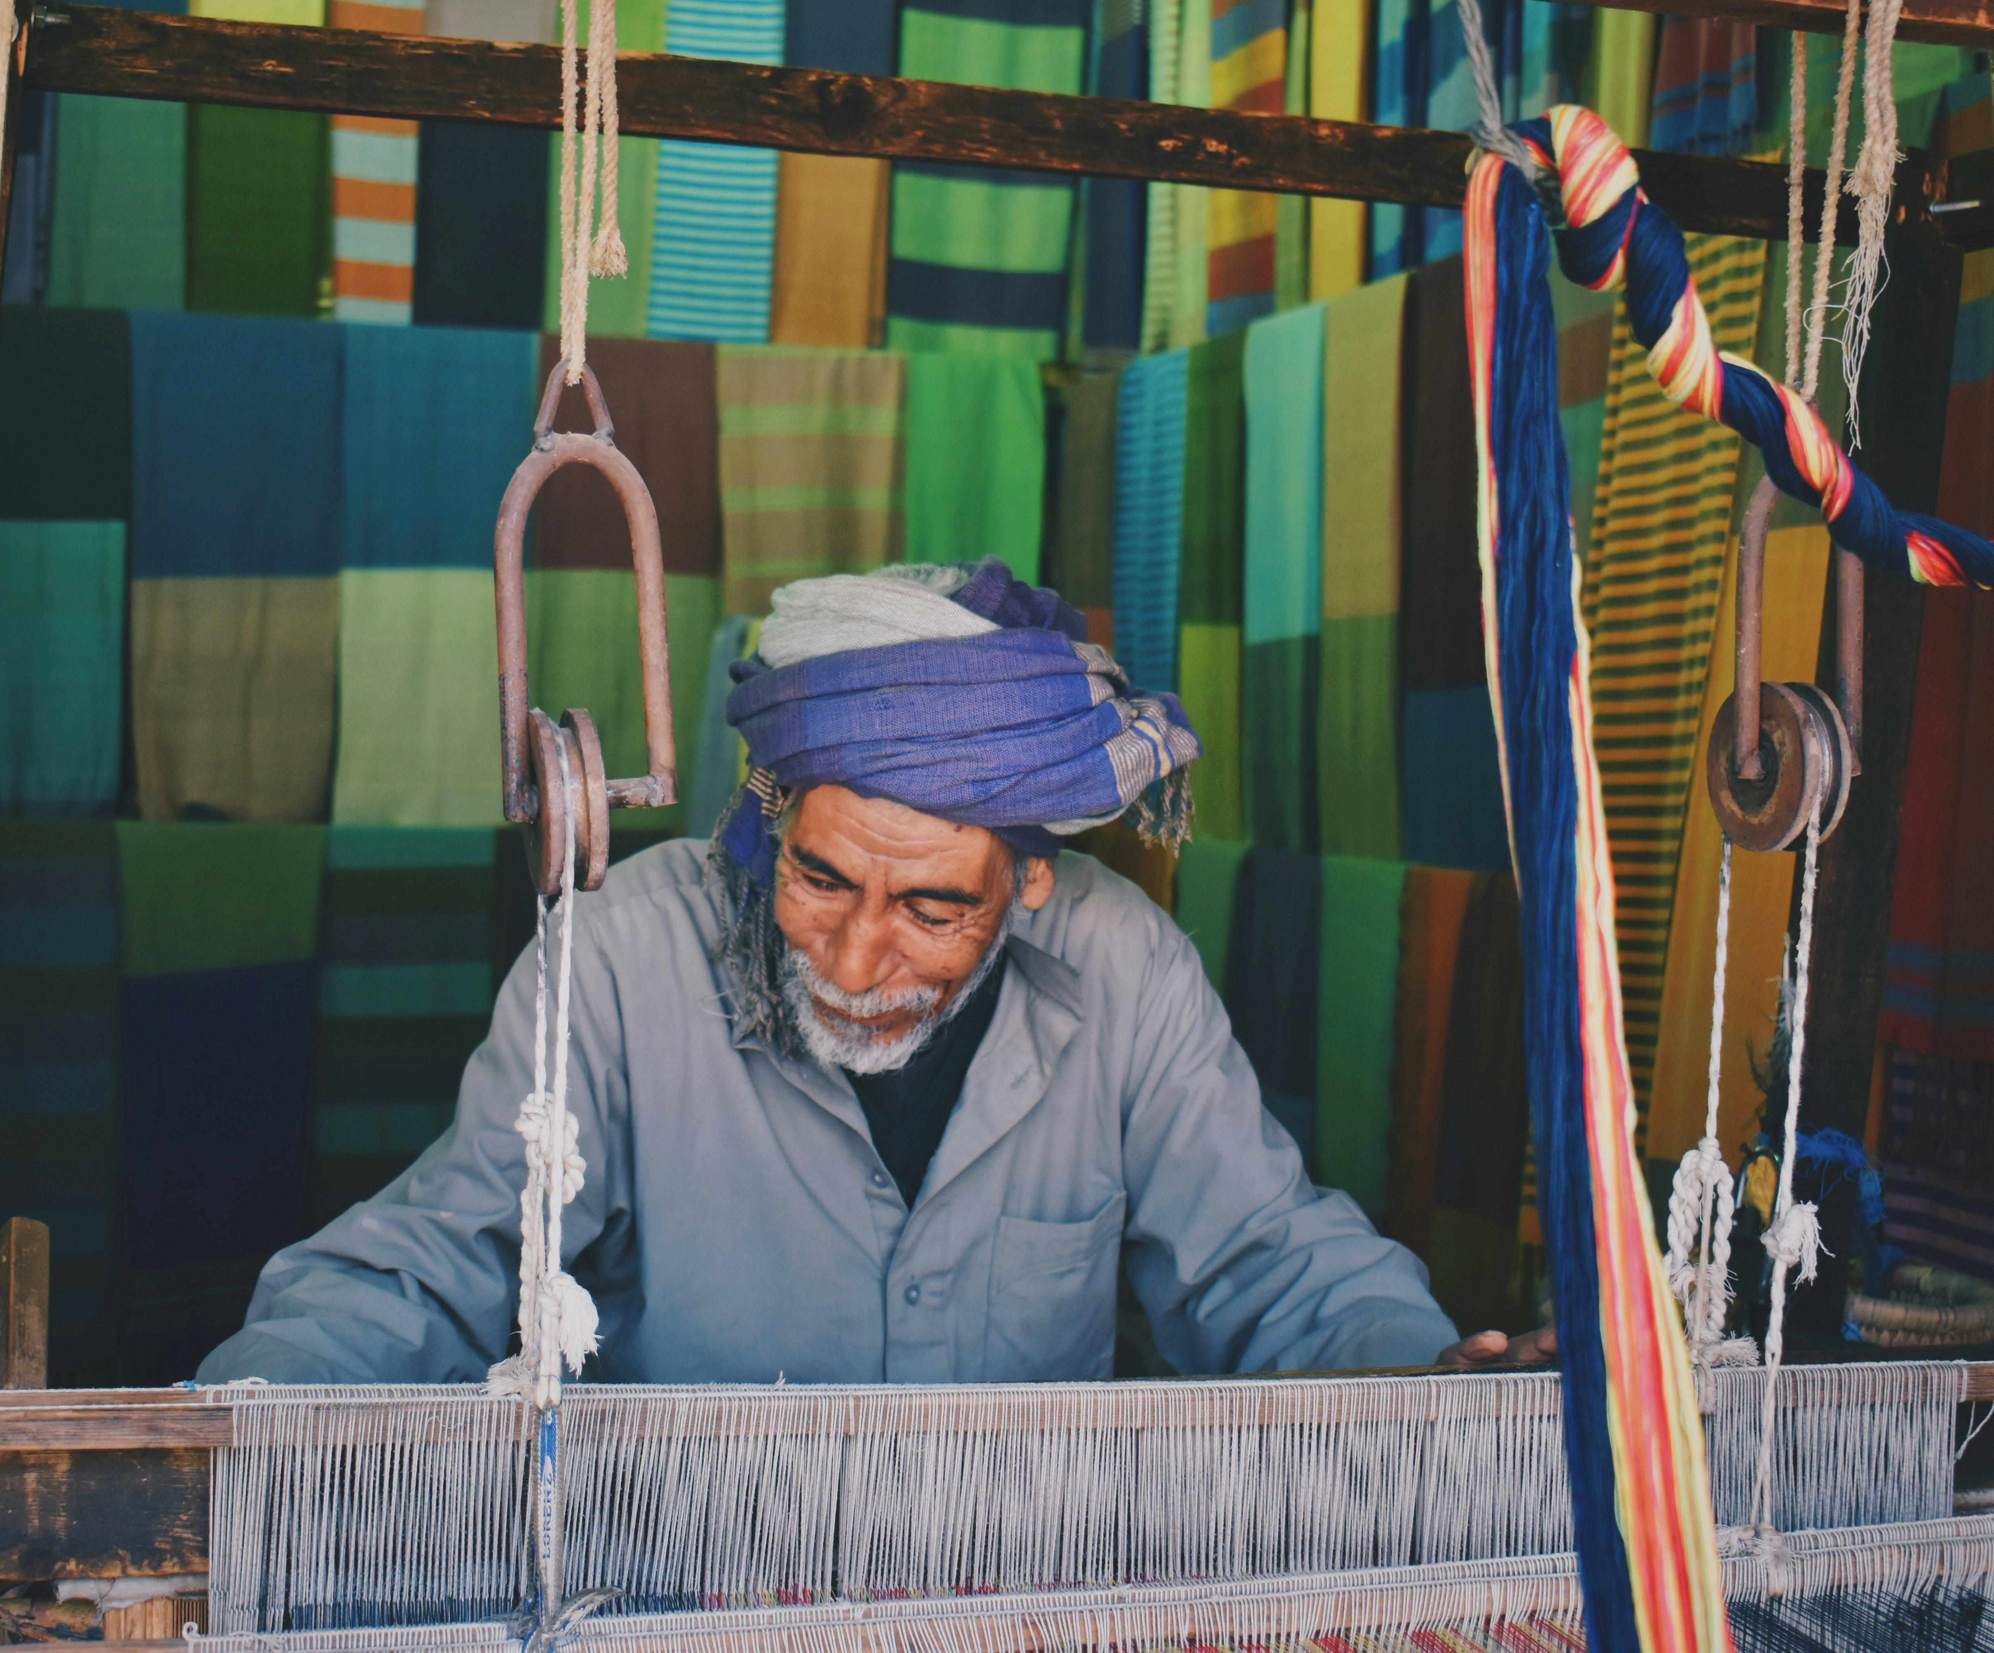
INTERWOVEN
Teaching Language and Culture in a Digitally Connected World

